Slide 1
Welcome to our annual Theatre Celebration!
Please enjoy refreshments before we begin!

Slide 2
Theatre Memories
2022-2023
What a great season of theatre!

Slide 3
It all started with….

Slide 4
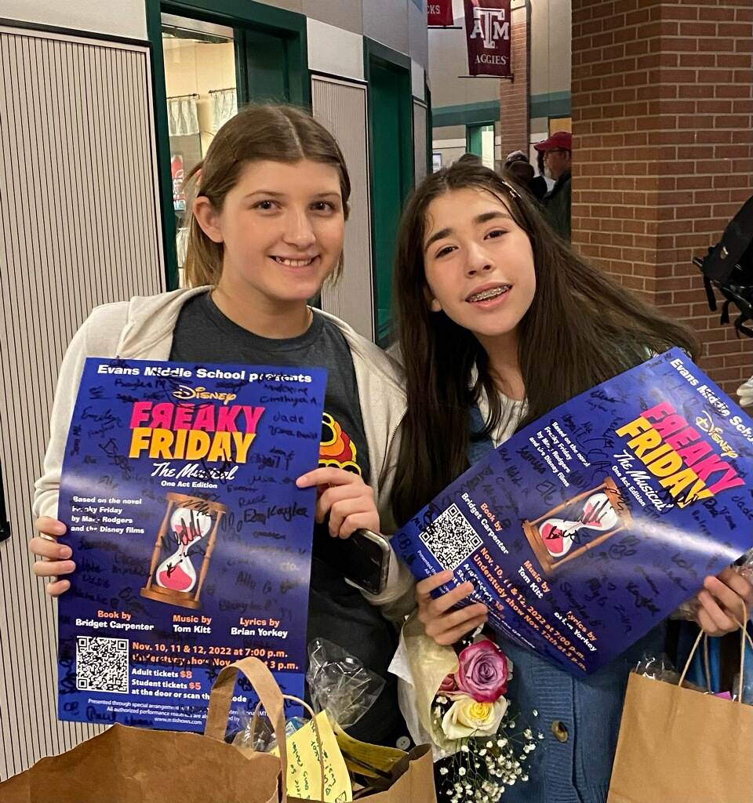

Slide 5
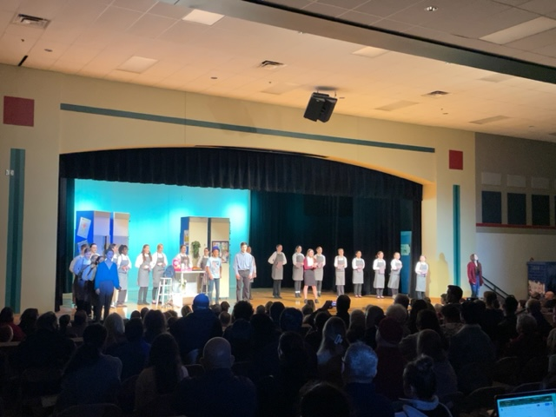

Slide 6
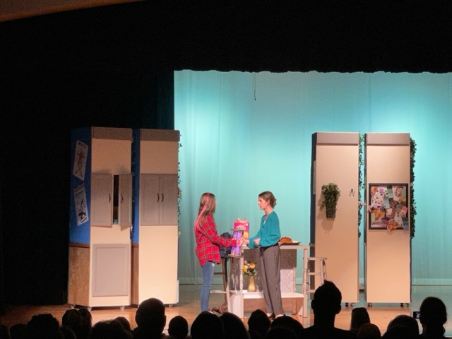

Slide 7
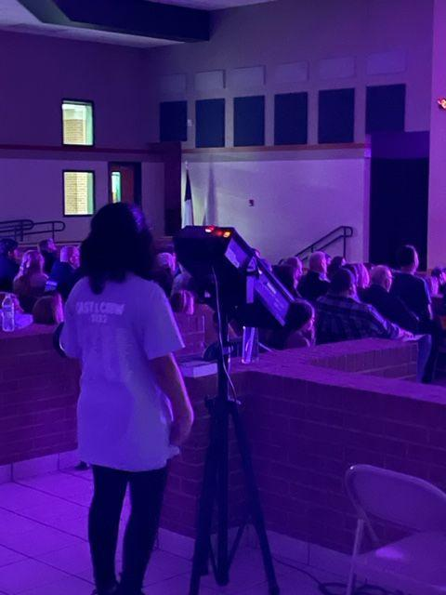
Ziva on spotlight!

Slide 8
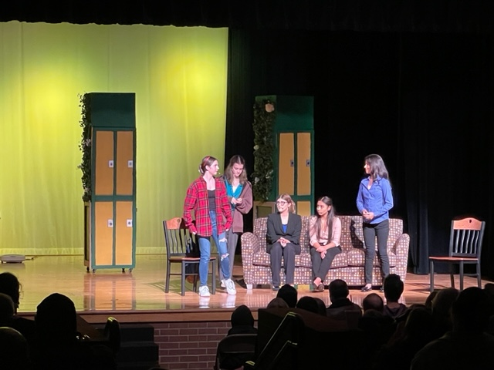

Slide 9
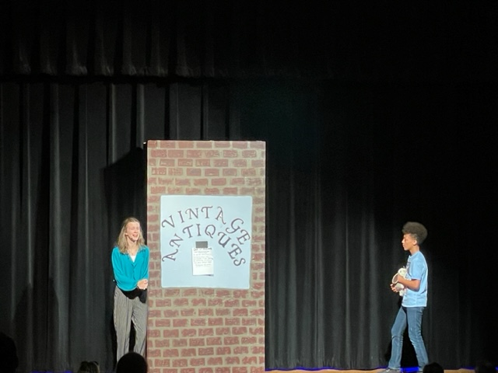

Slide 10
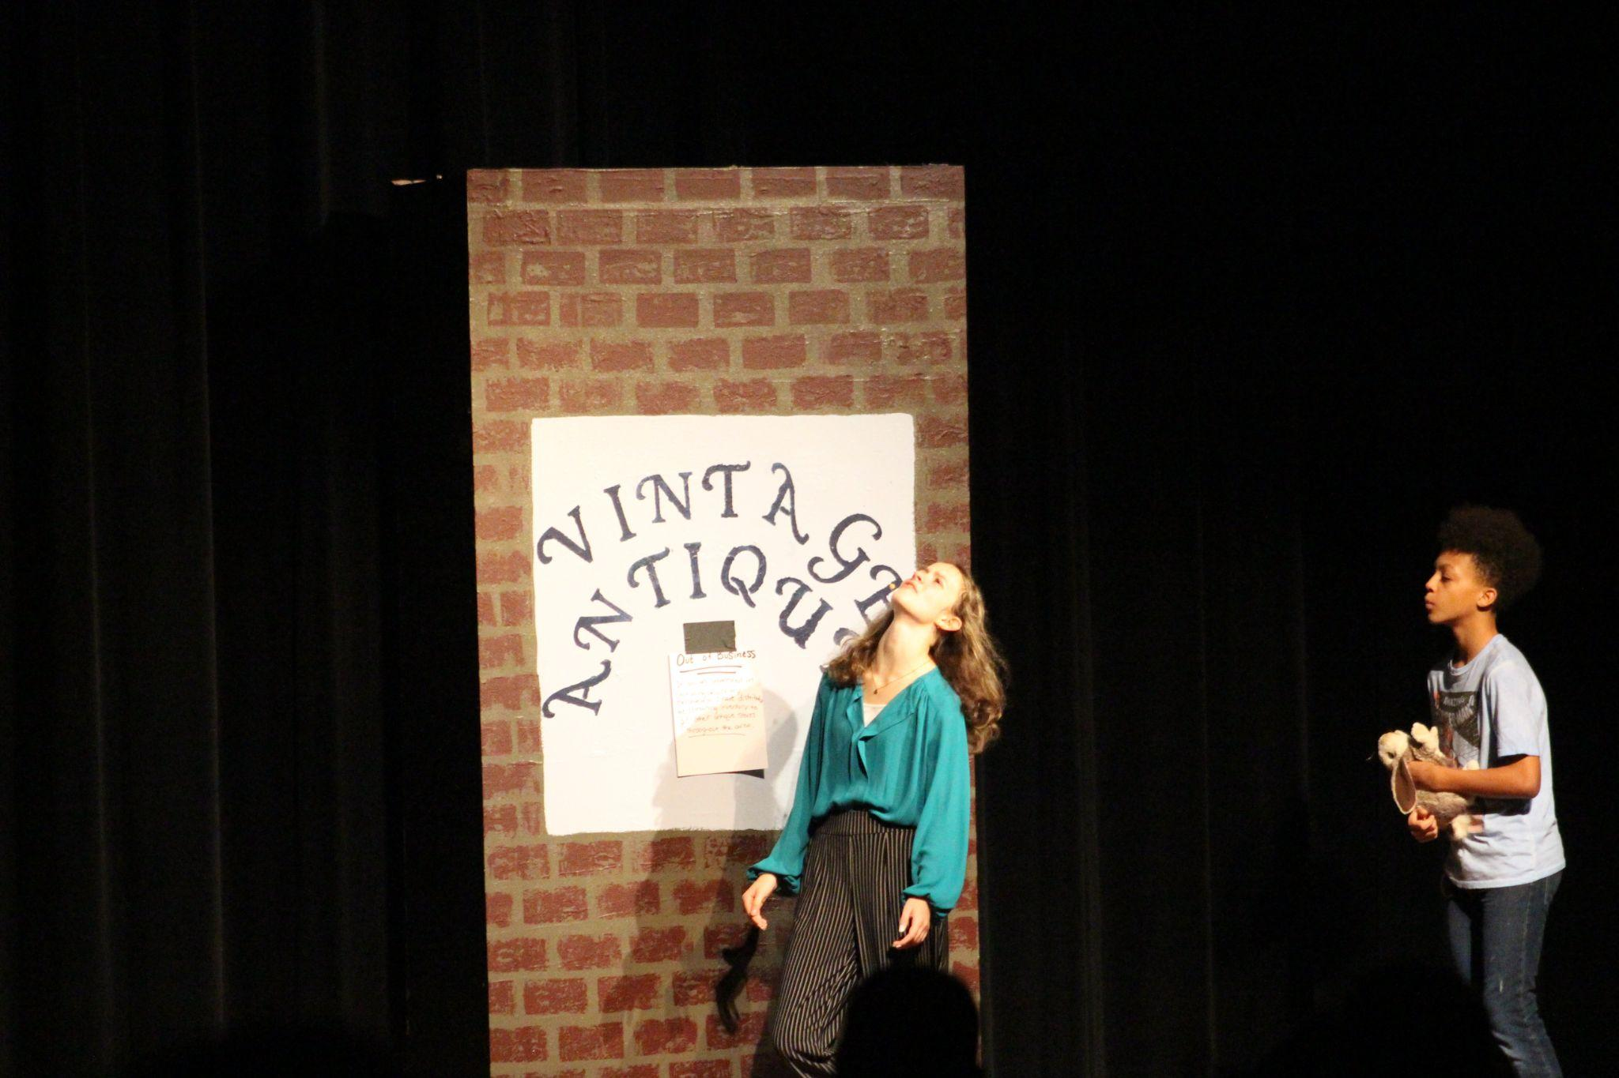

Slide 11
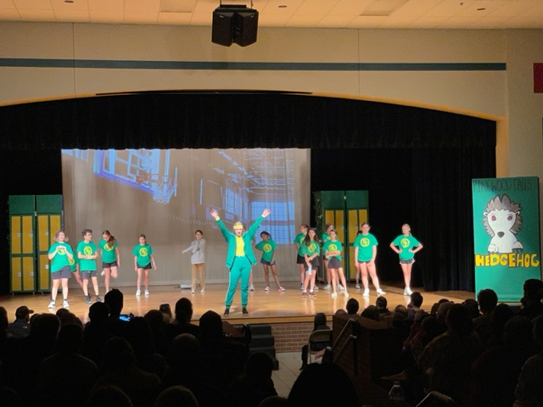

Slide 12
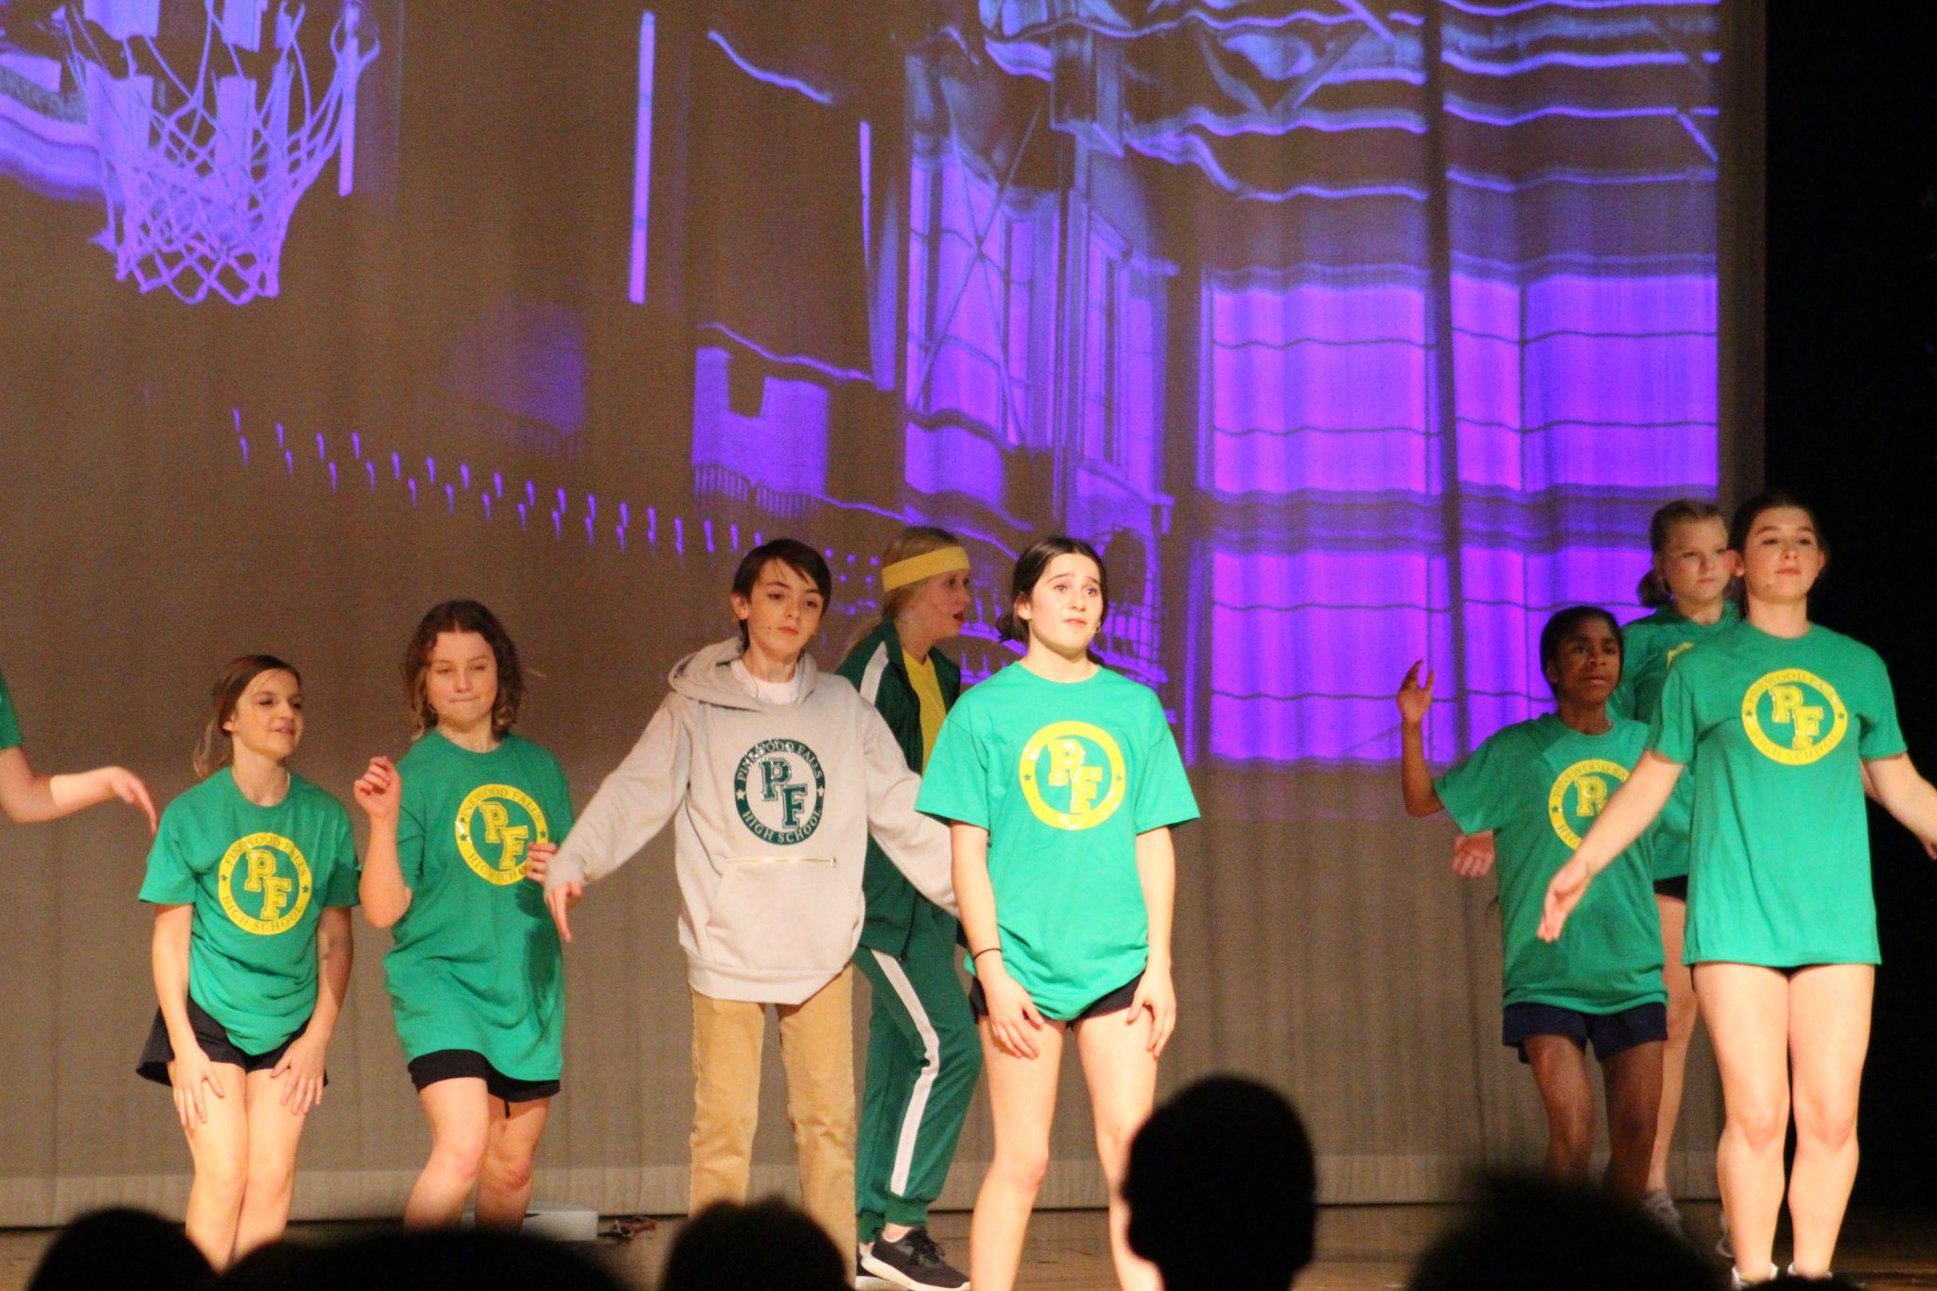

Slide 13
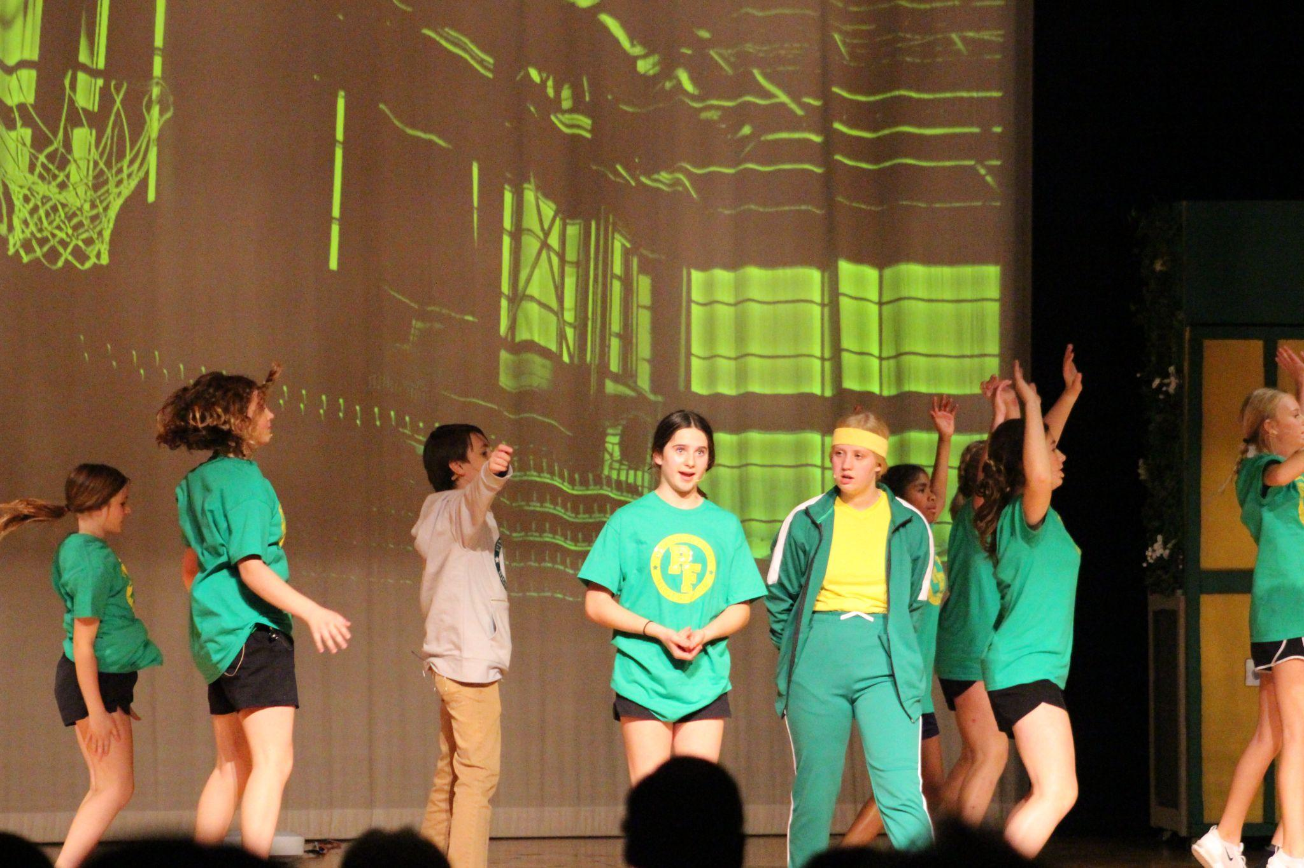

Slide 14
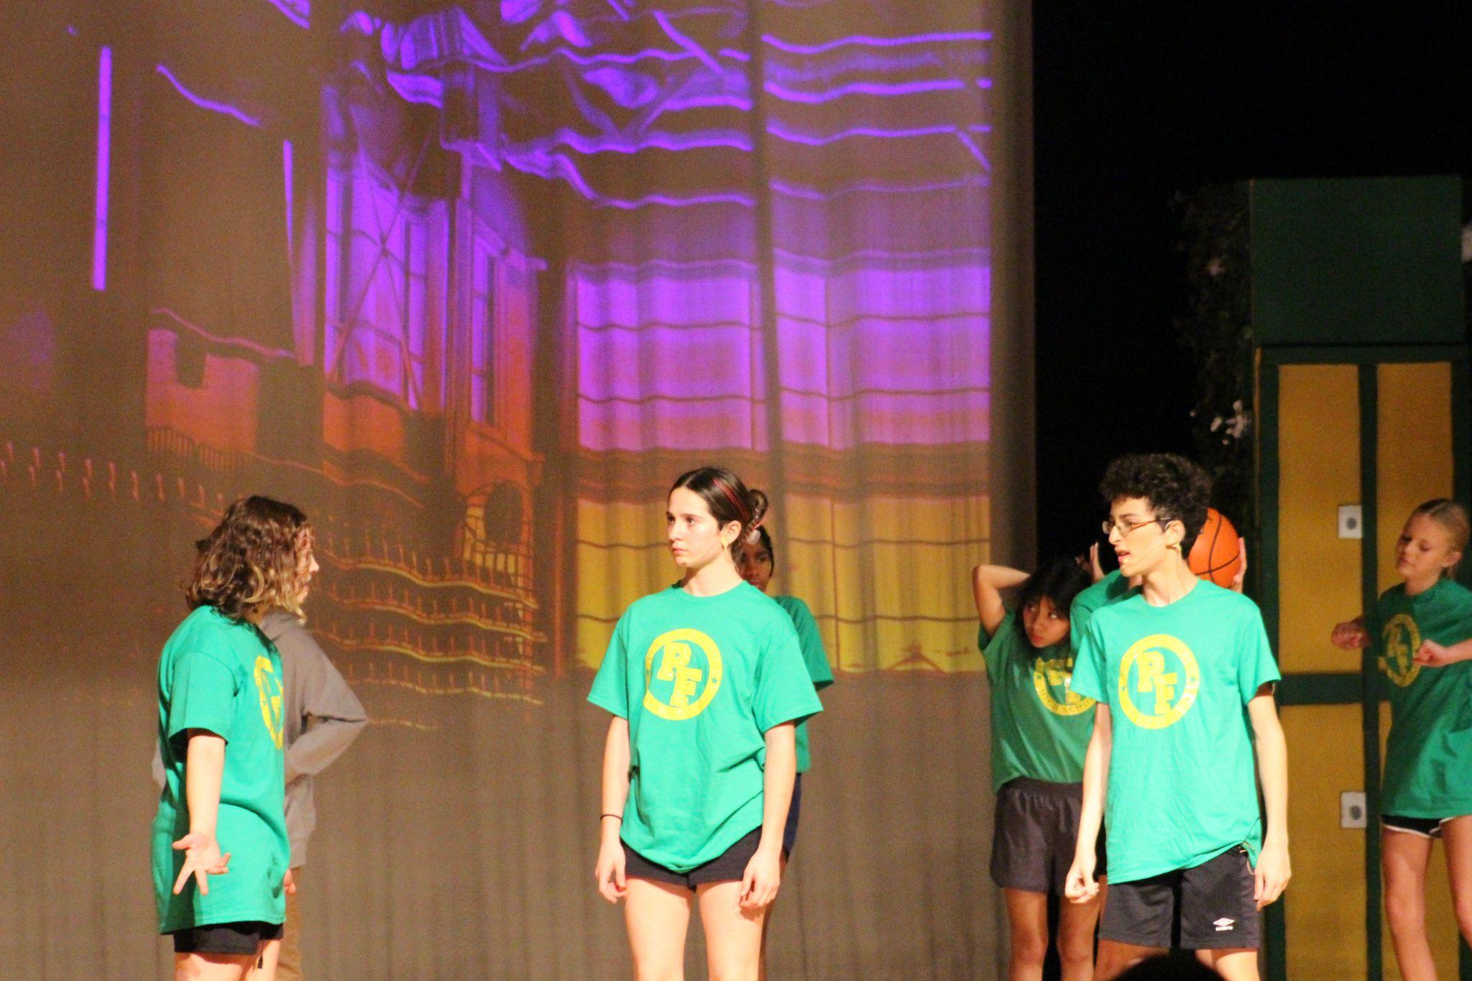

Slide 15
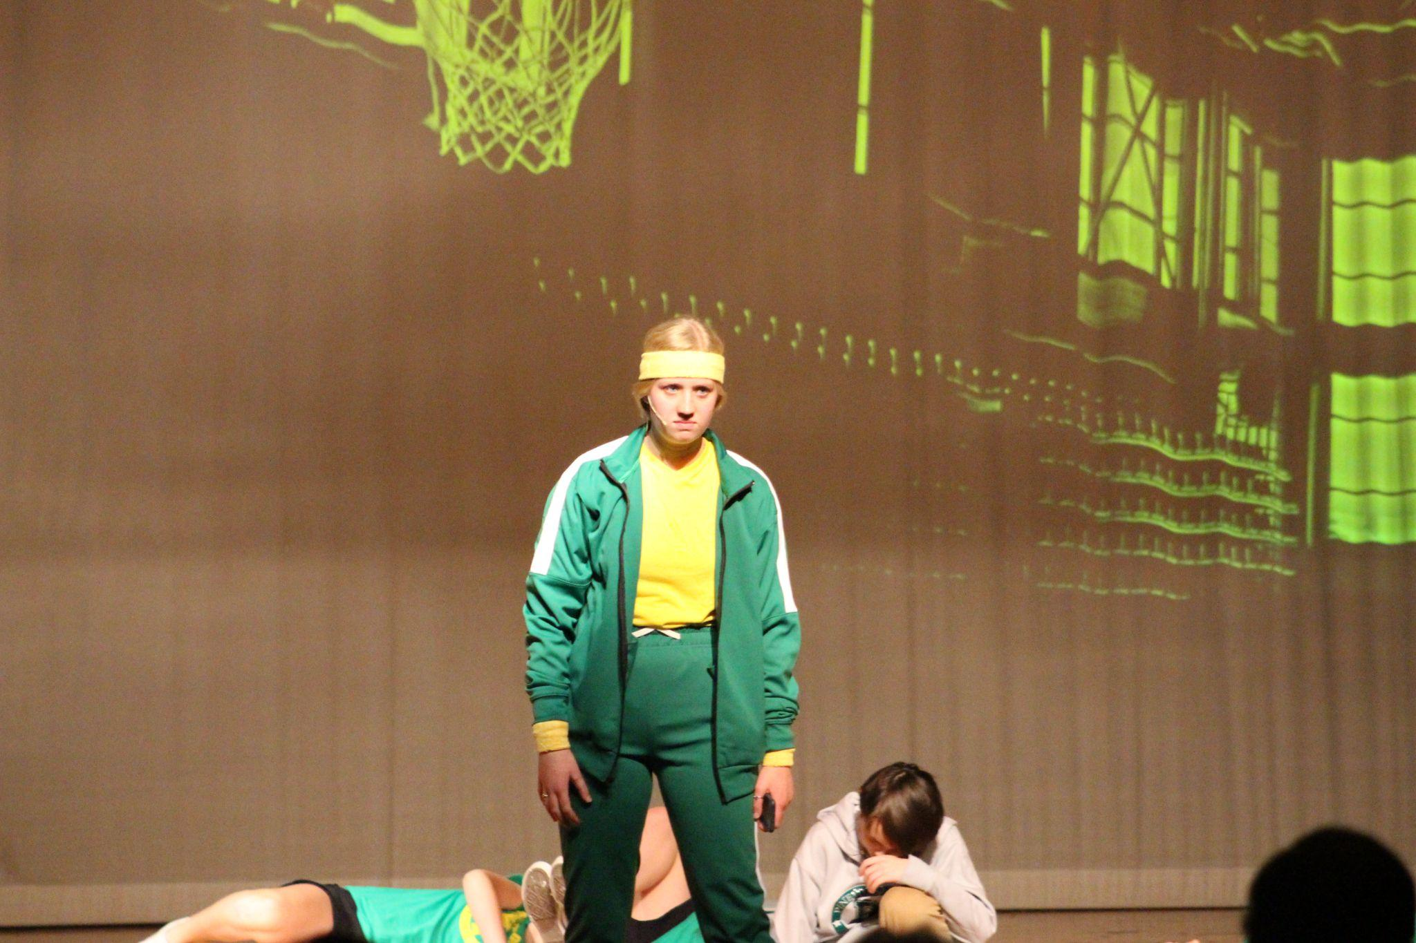

Slide 16
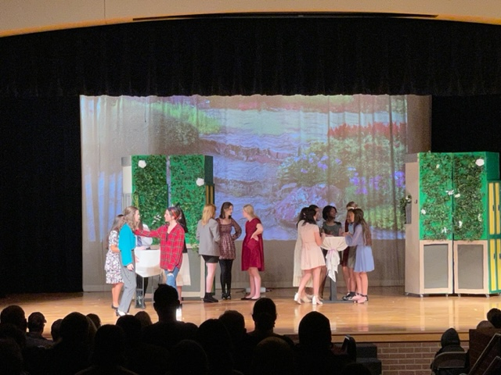

Slide 17
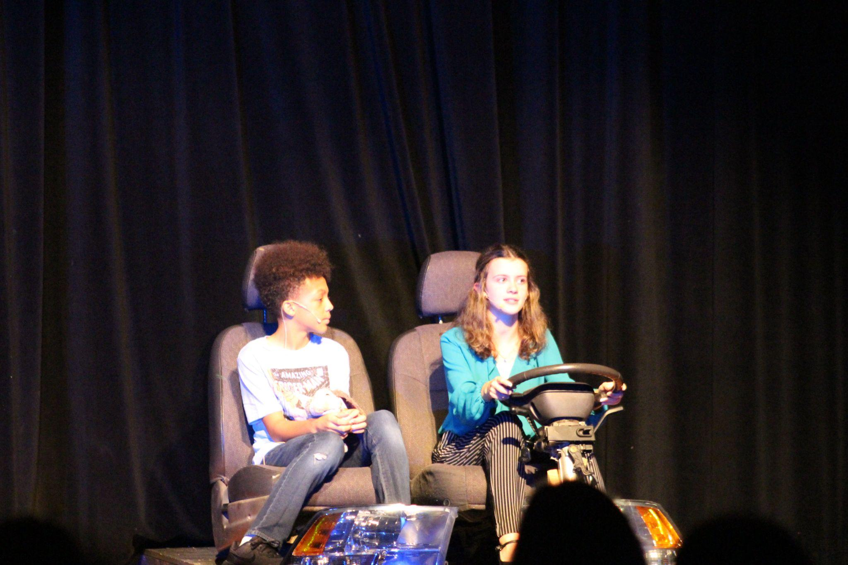

Slide 18
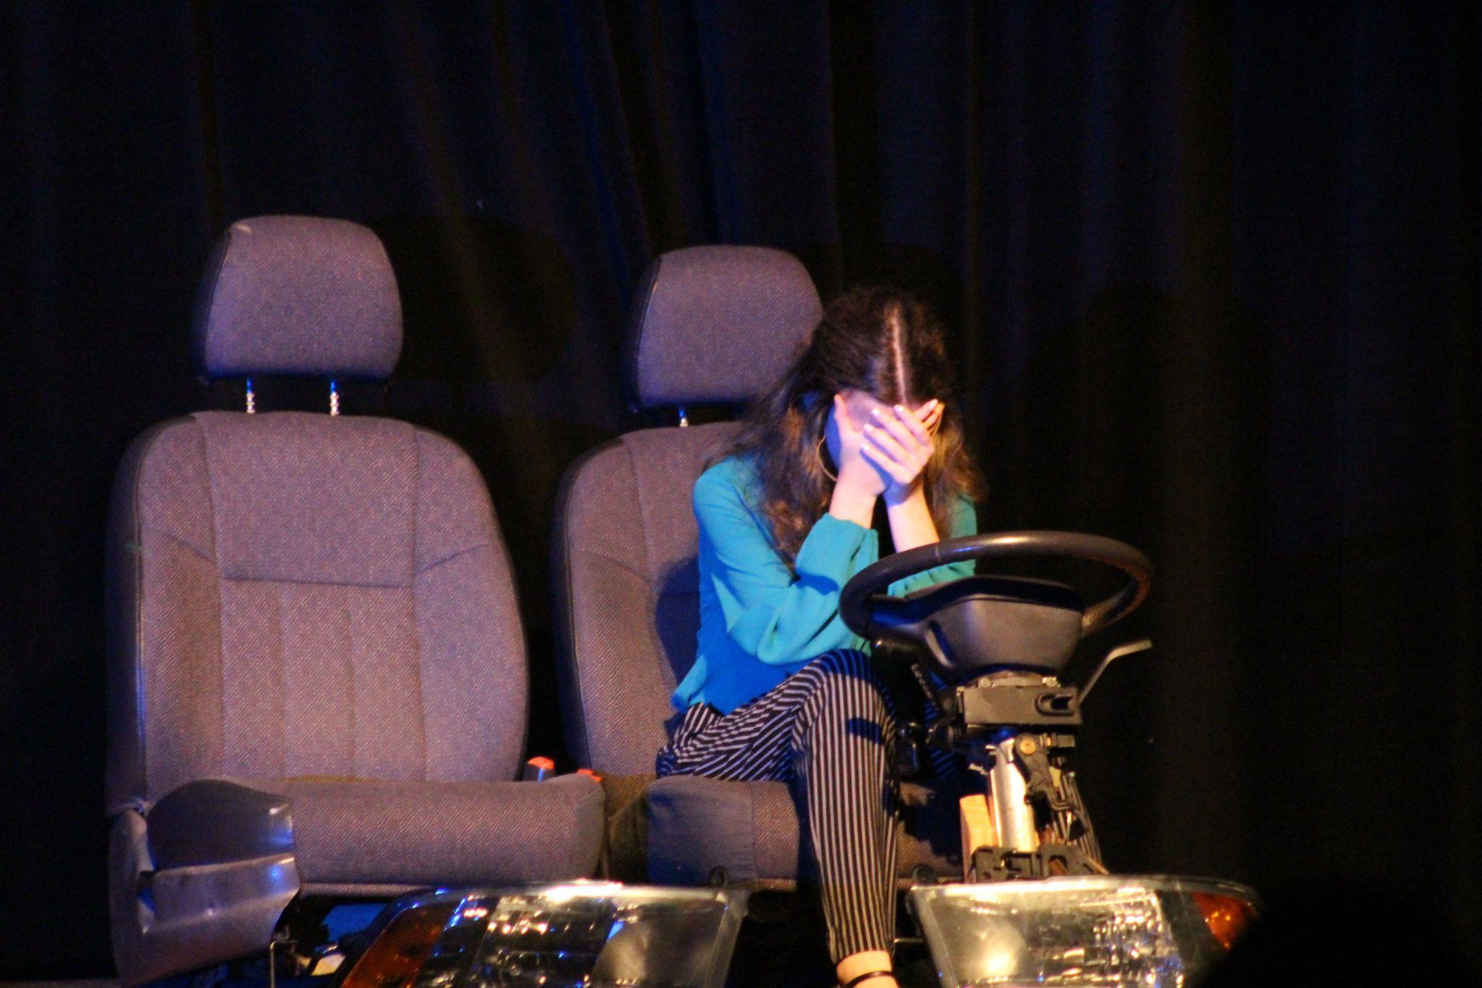

Slide 20
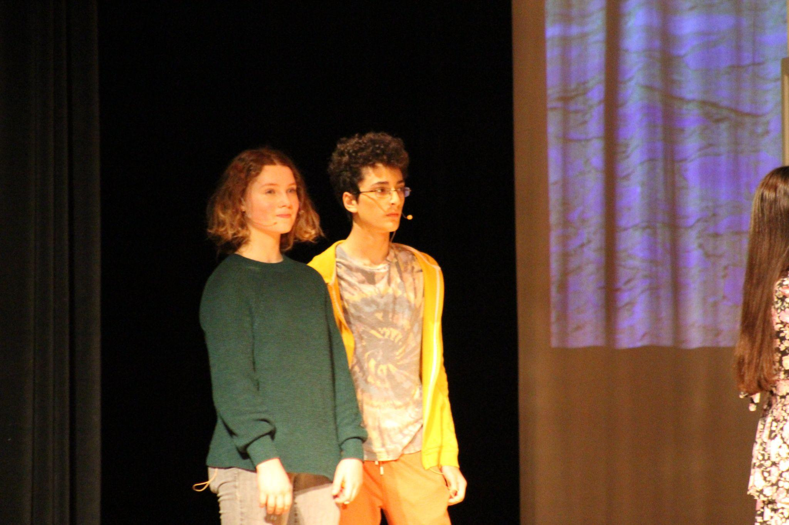

Slide 21
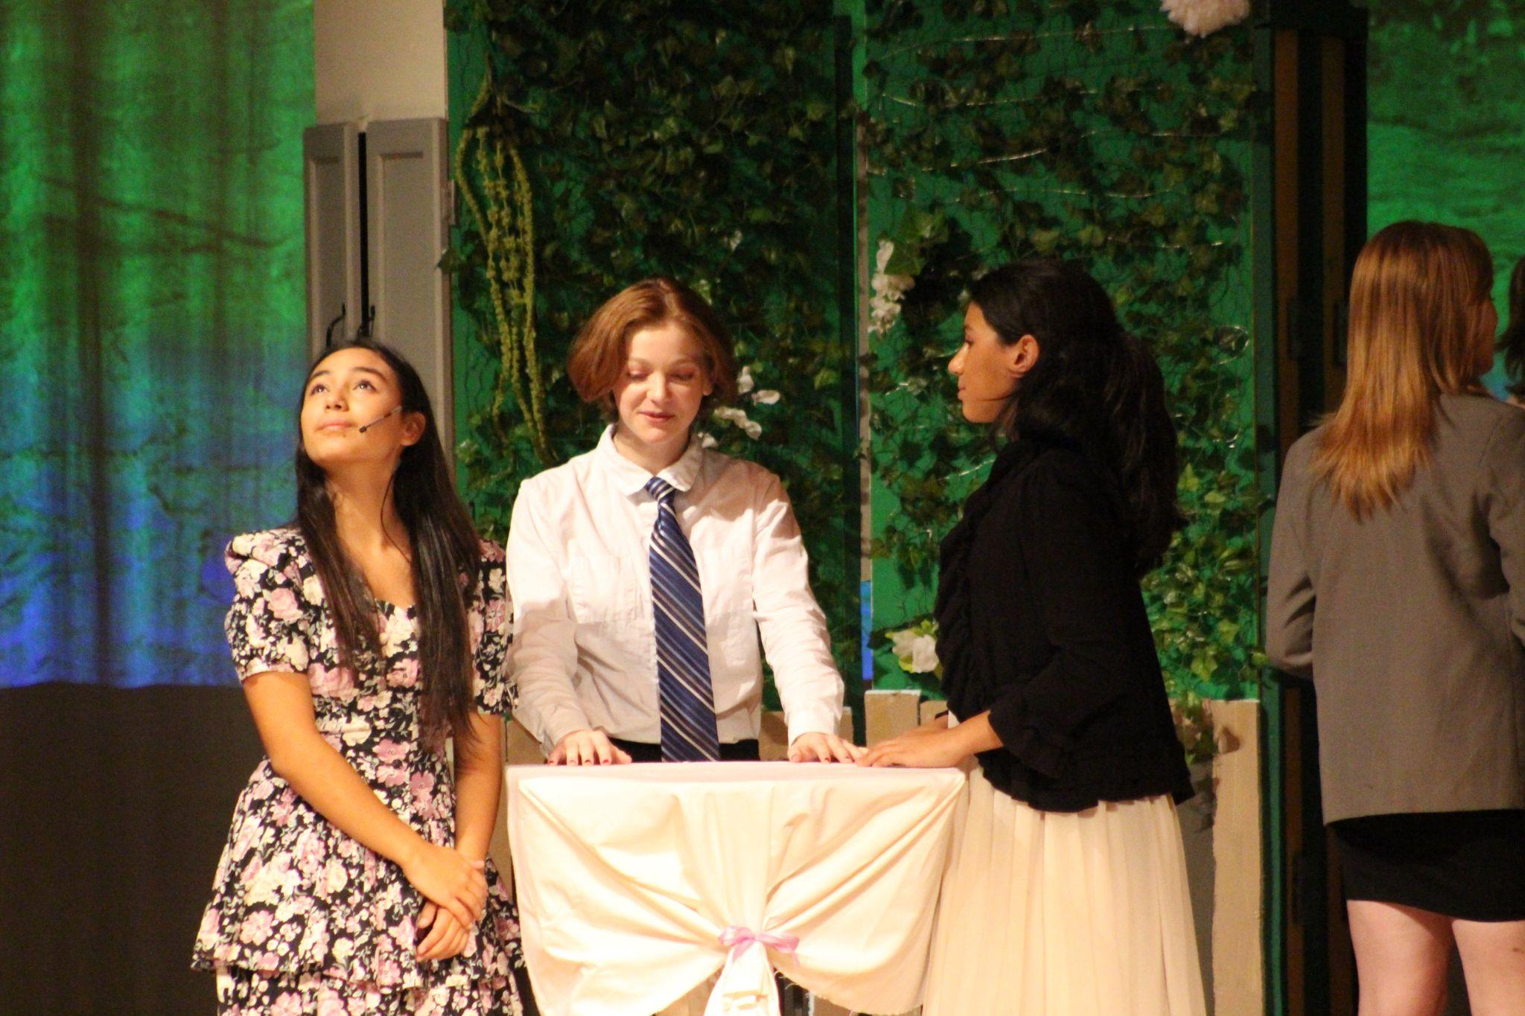

Slide 22
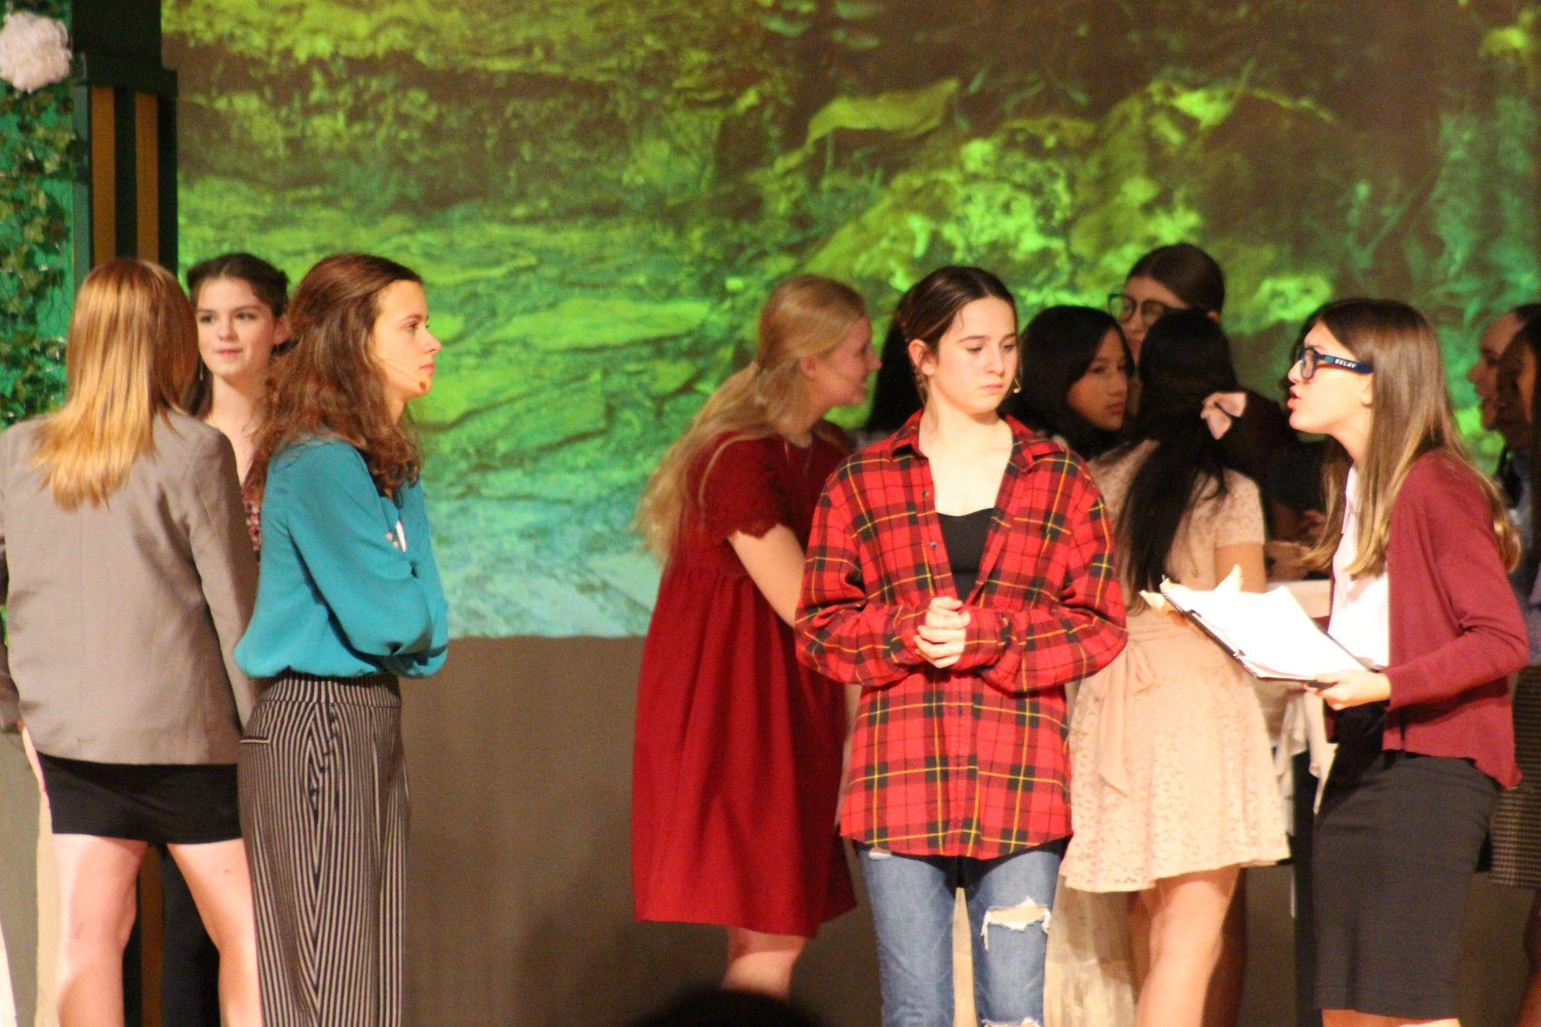

Slide 24
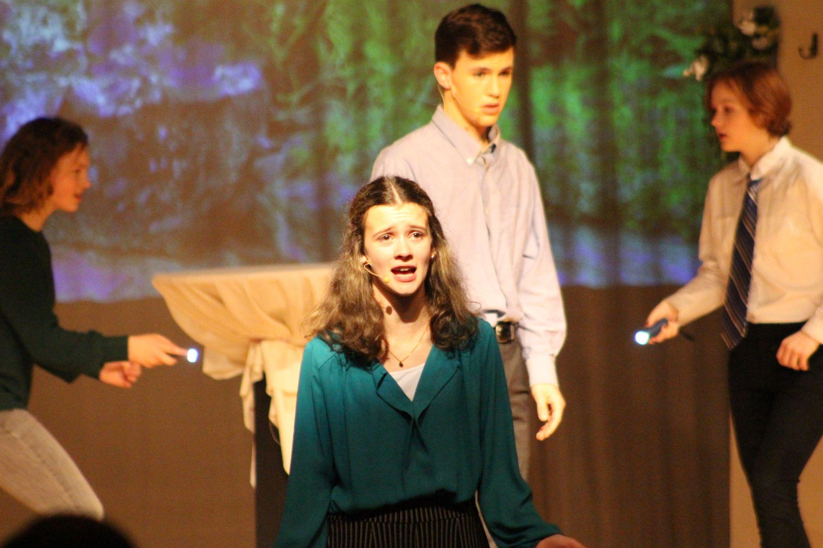

Slide 25
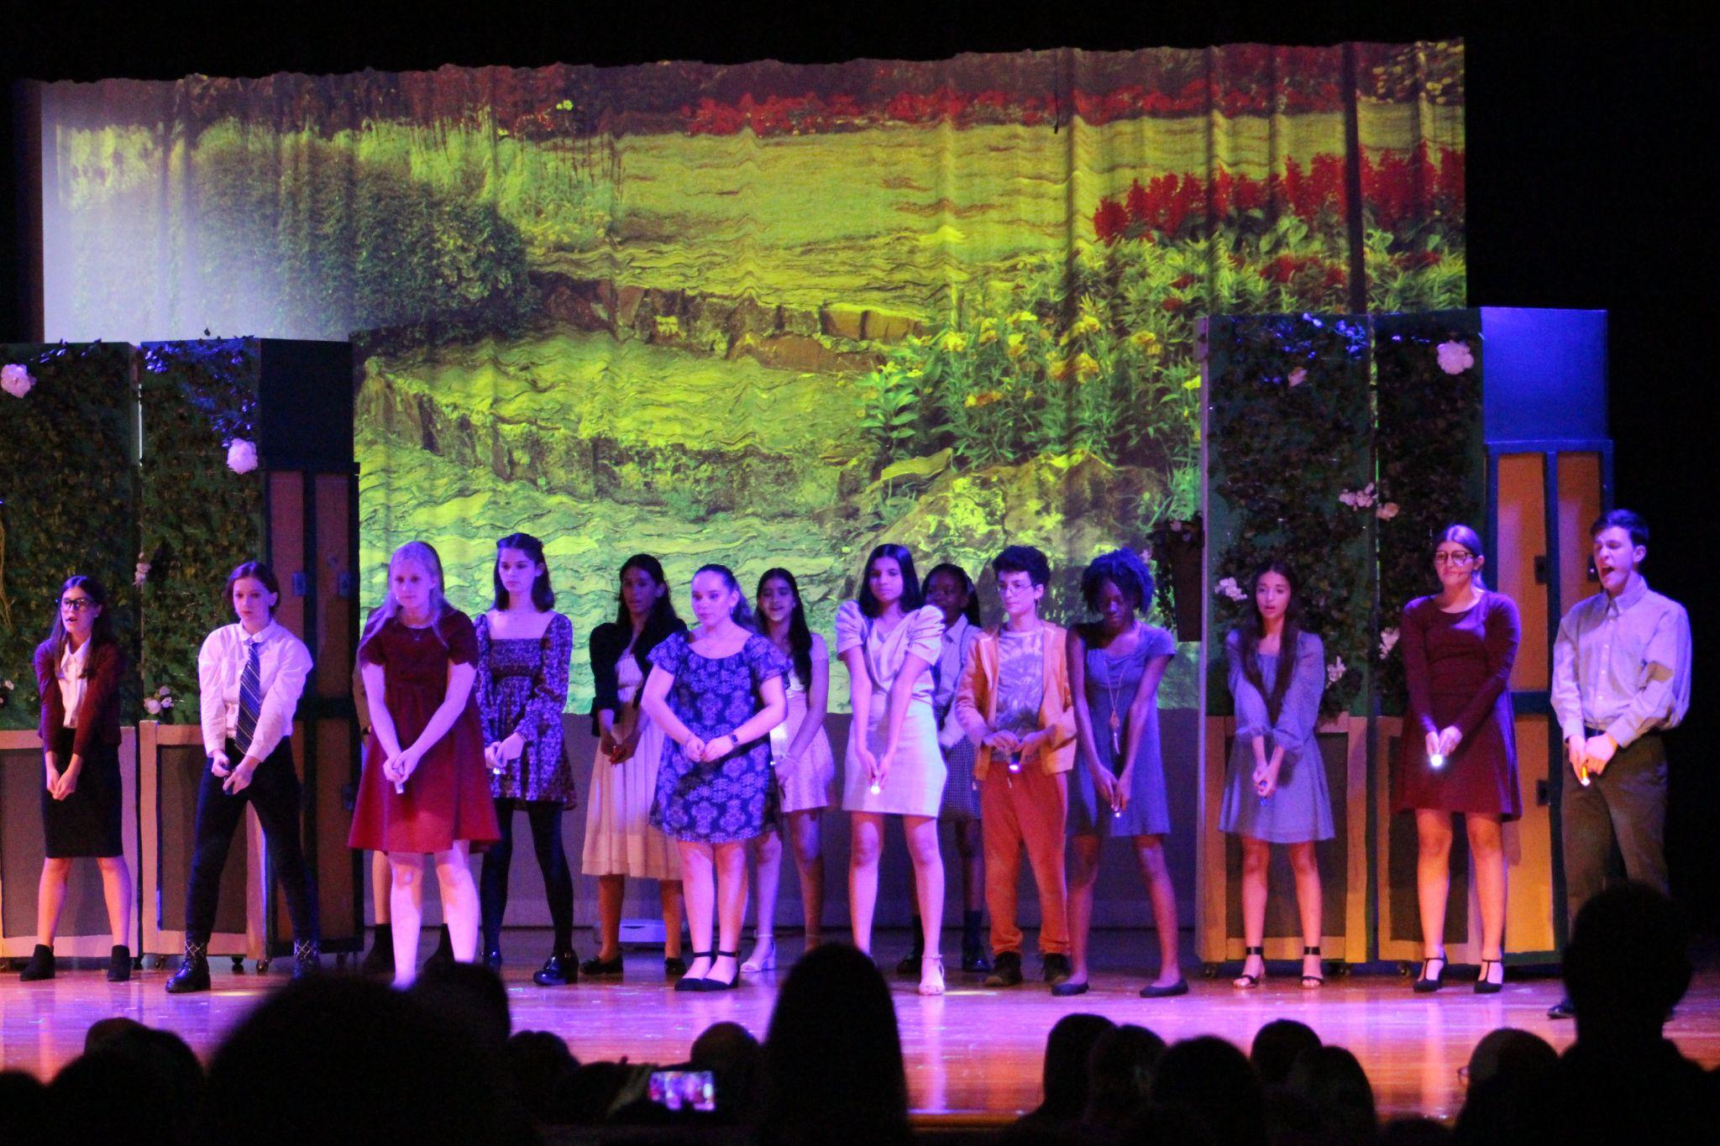

Slide 26
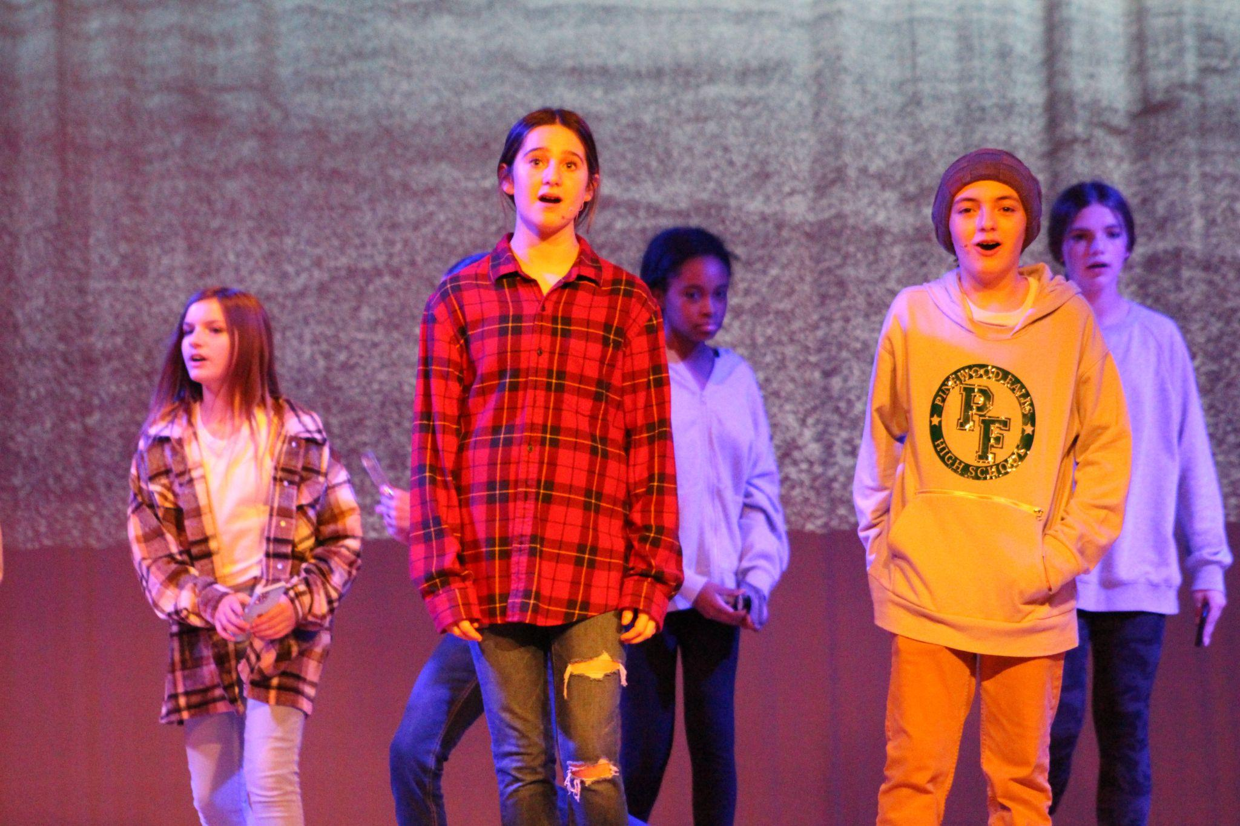

Slide 27
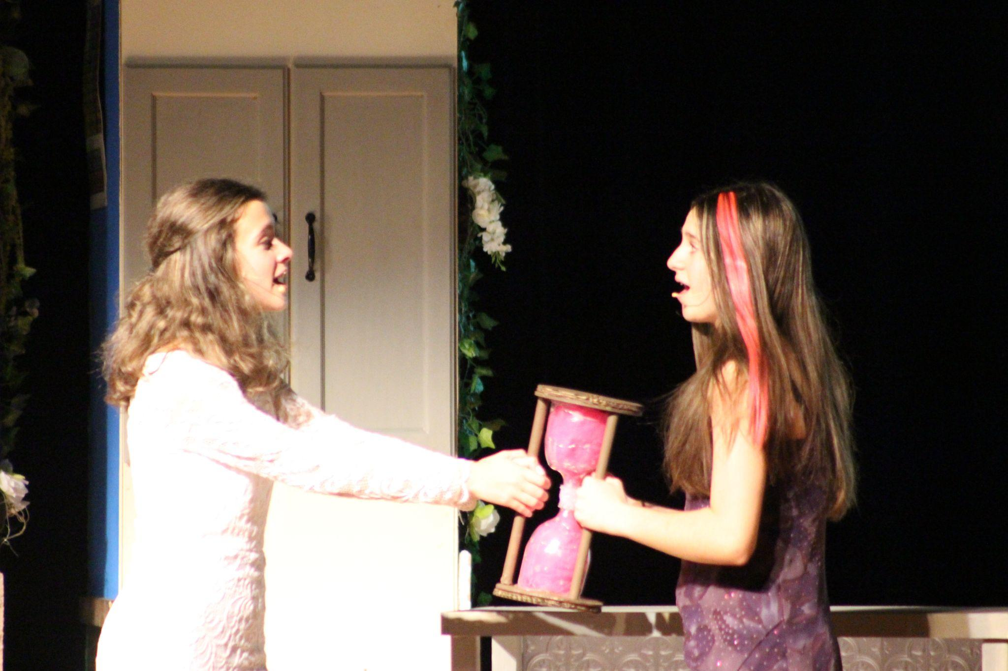

Slide 28
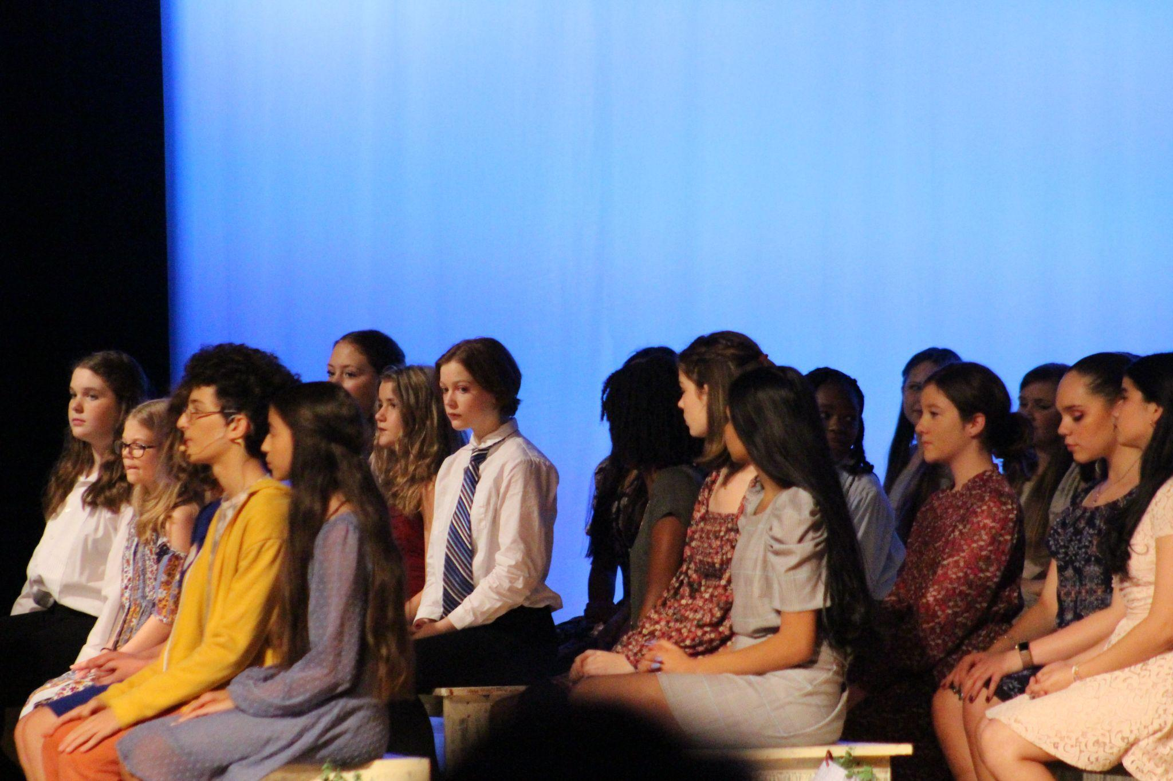

Slide 29
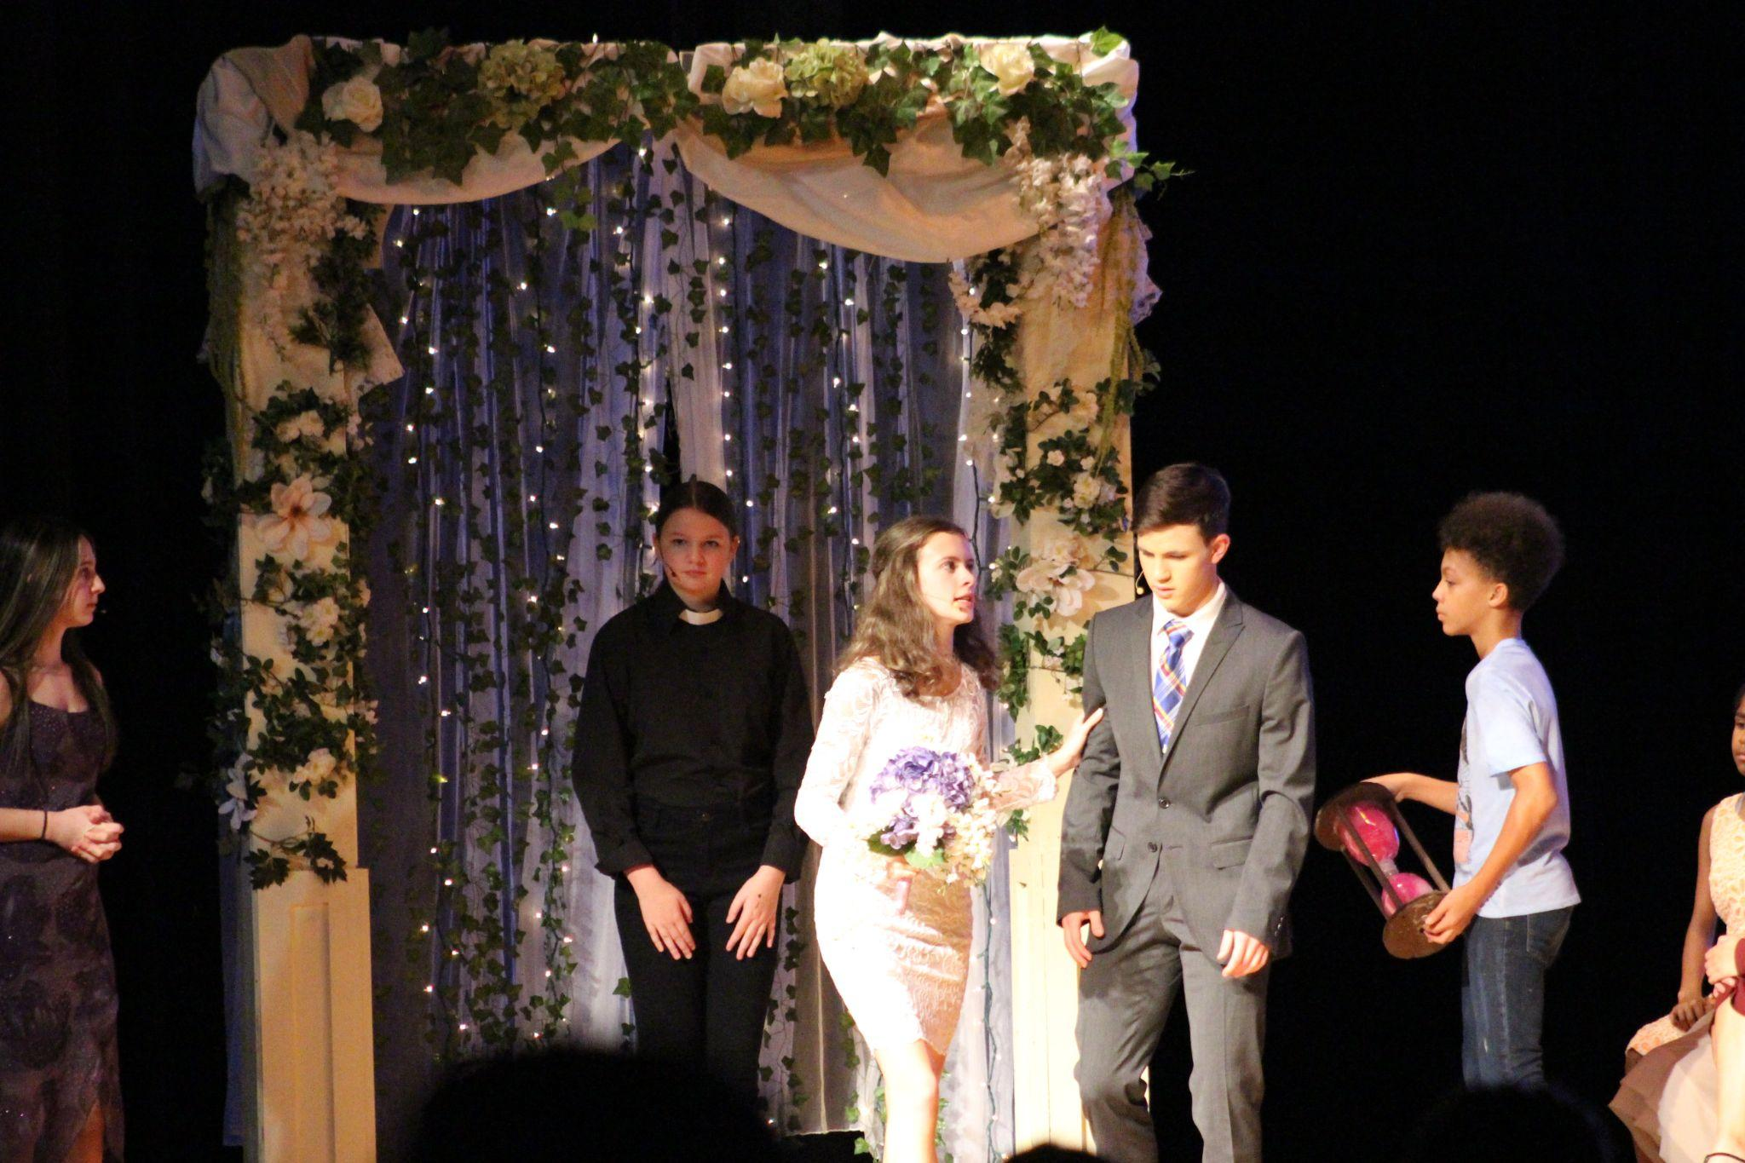

Slide 30
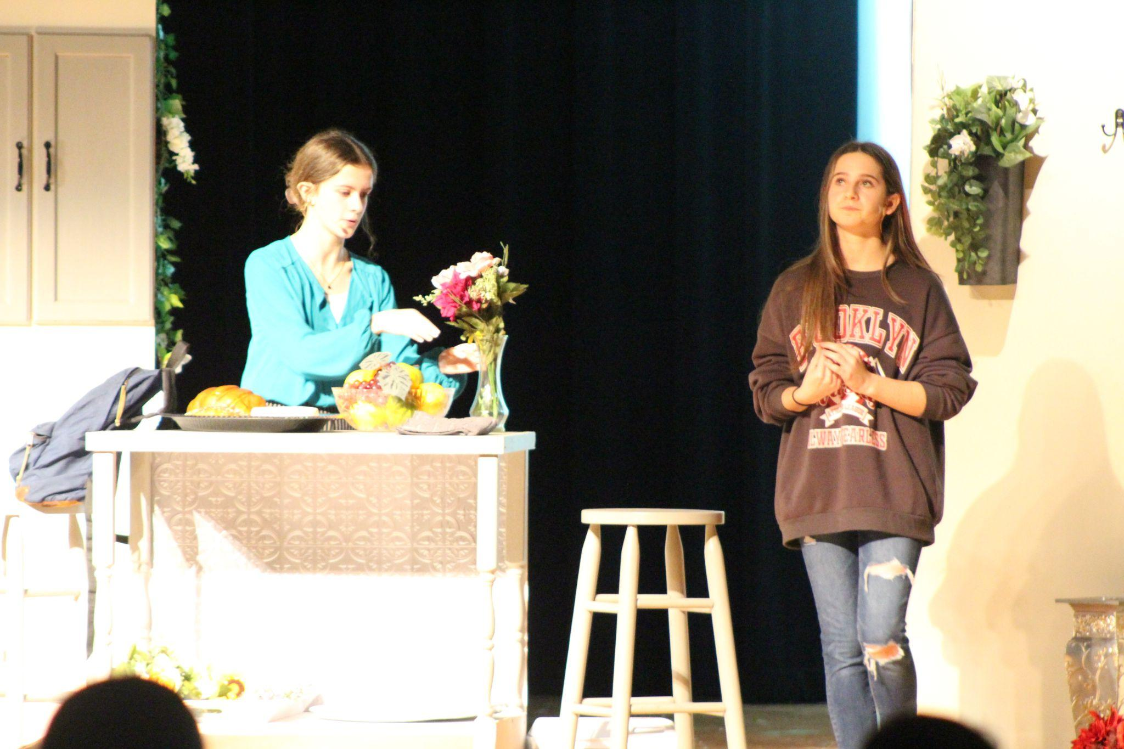

Slide 31
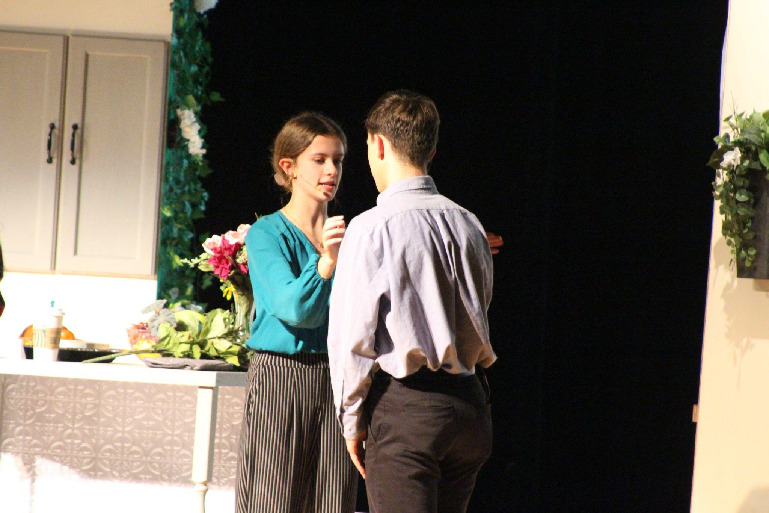

Slide 32
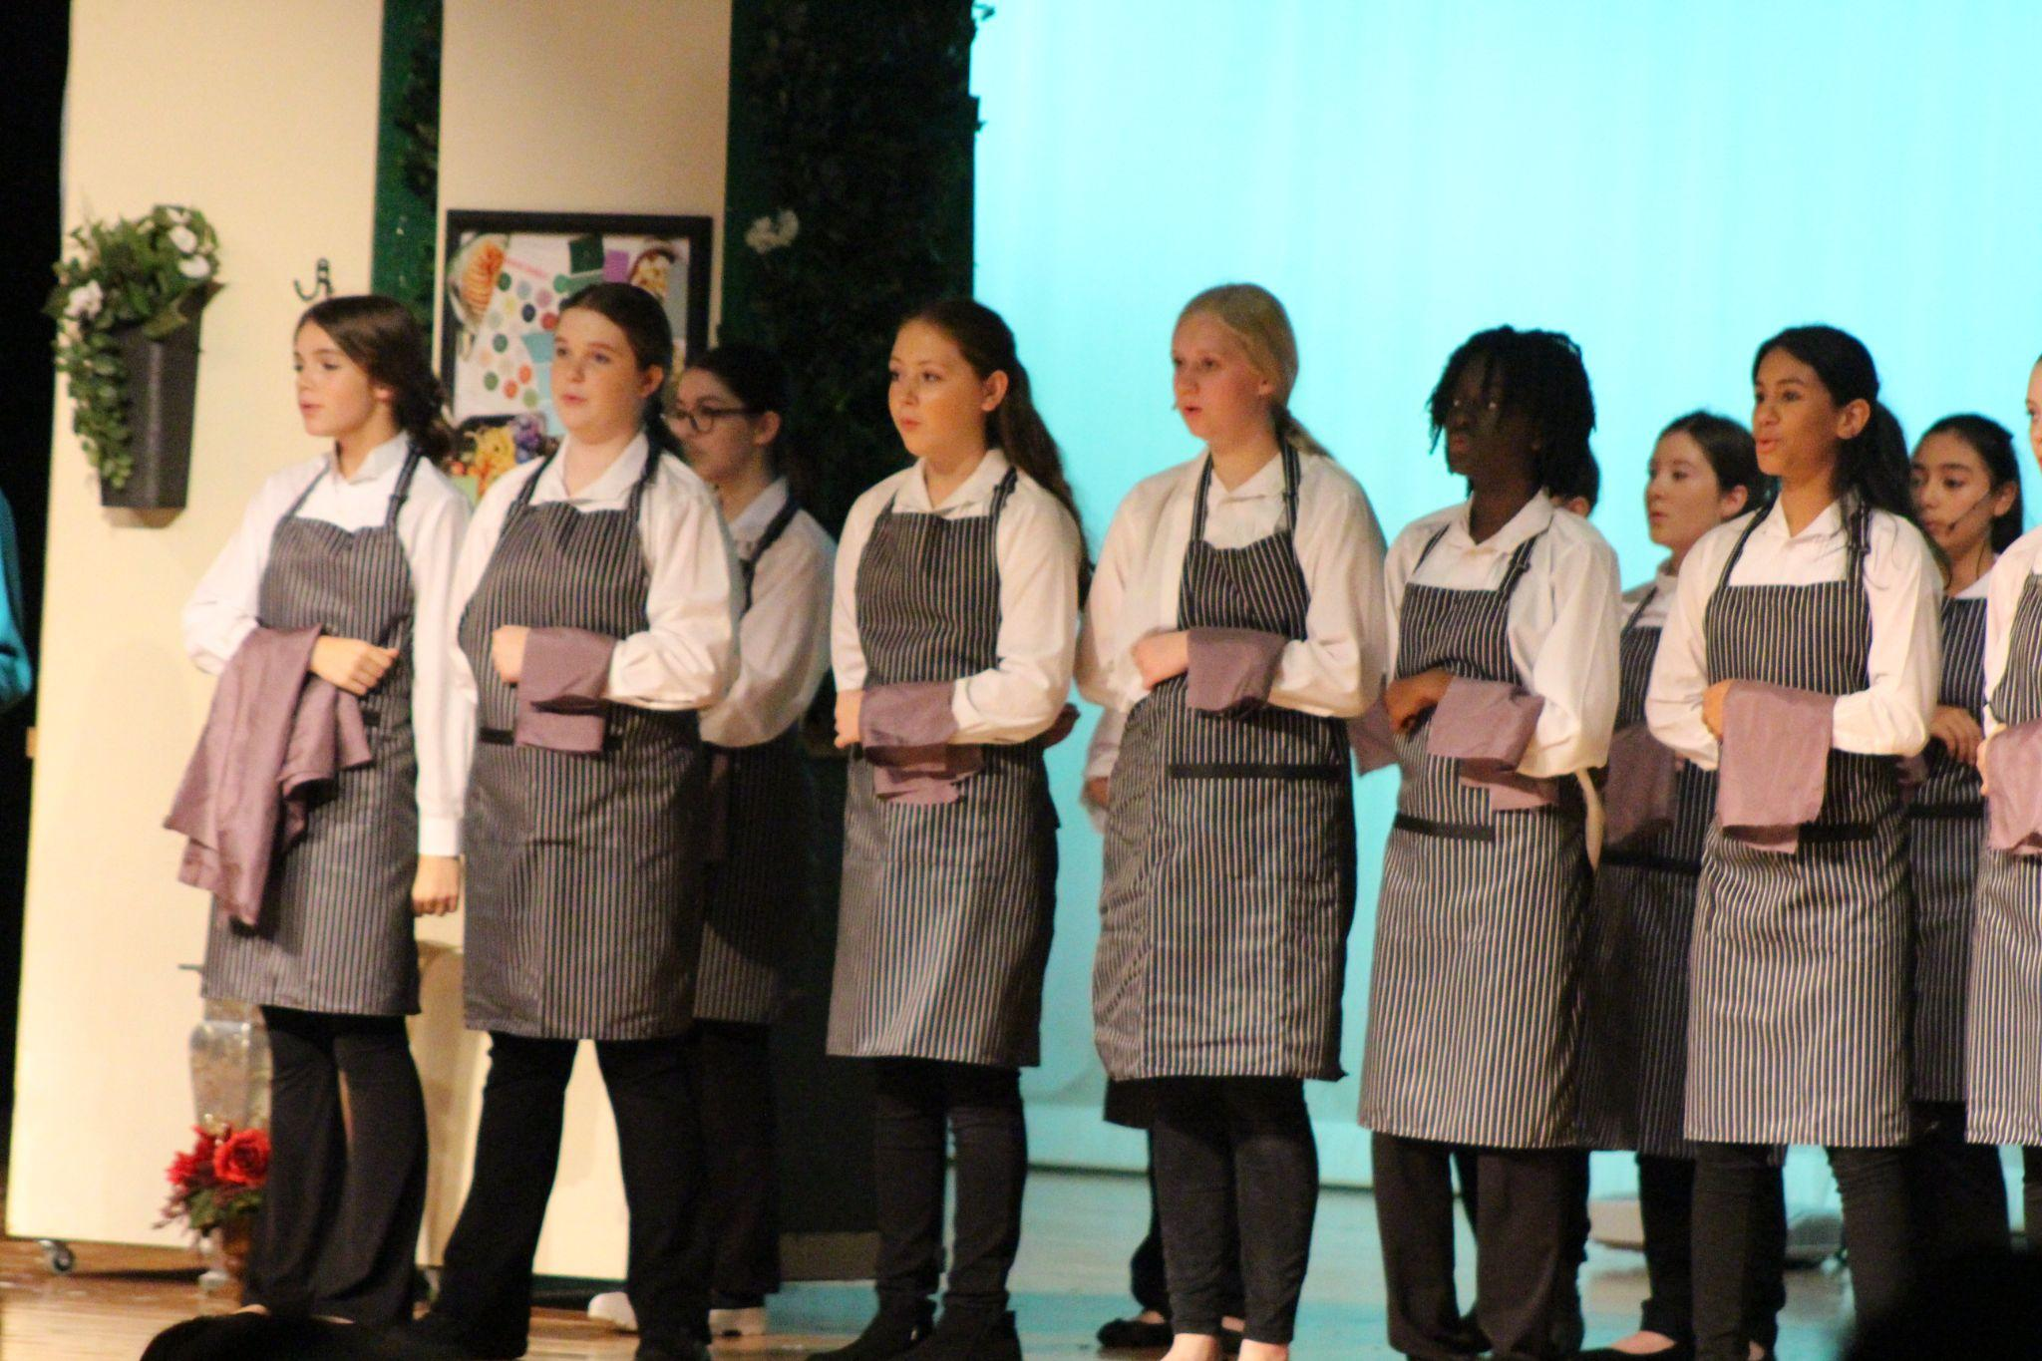

Slide 34
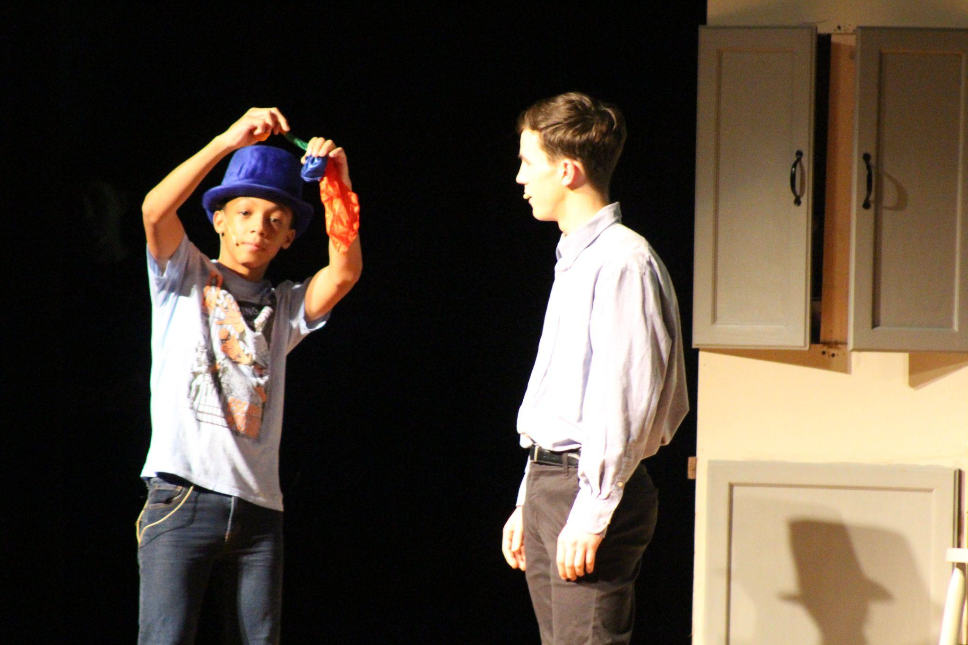

Slide 35
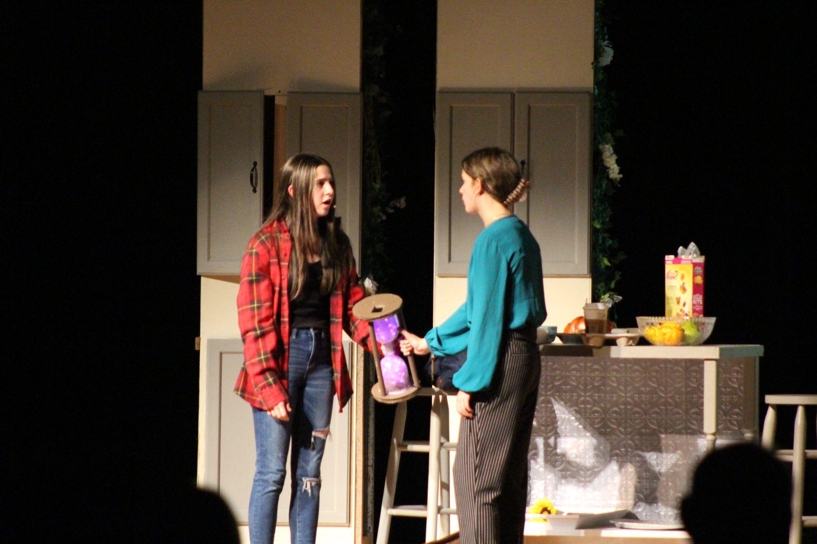

Slide 36
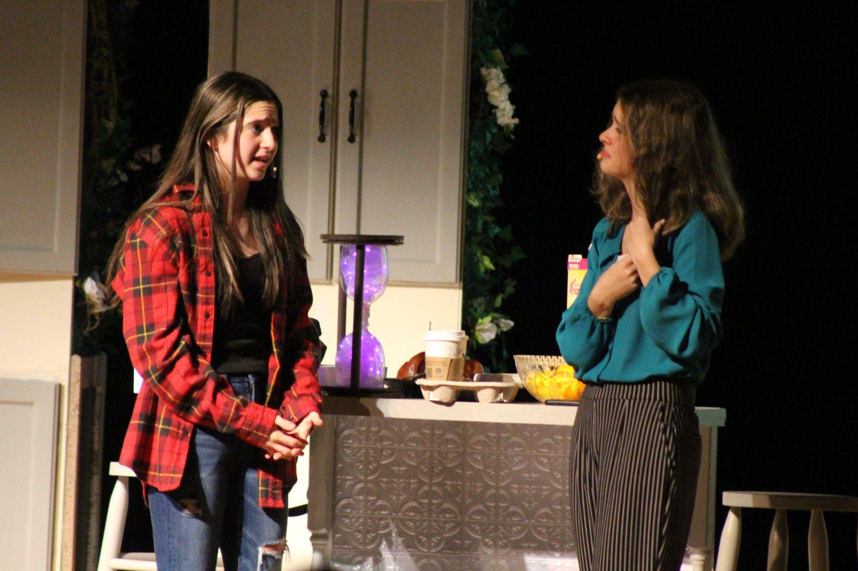

Slide 37
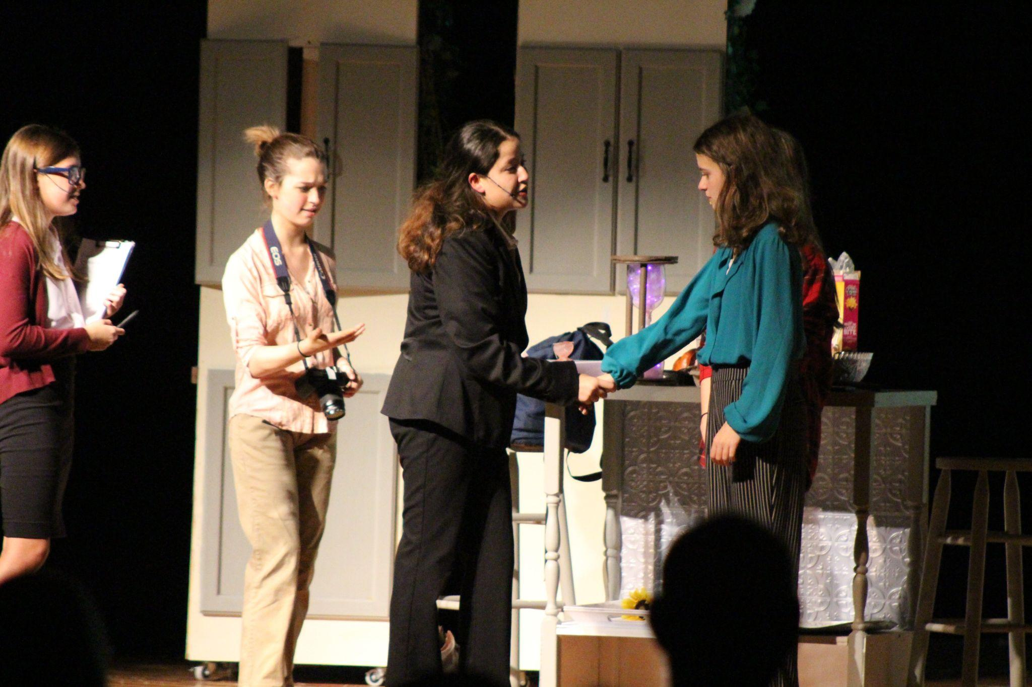

Slide 38
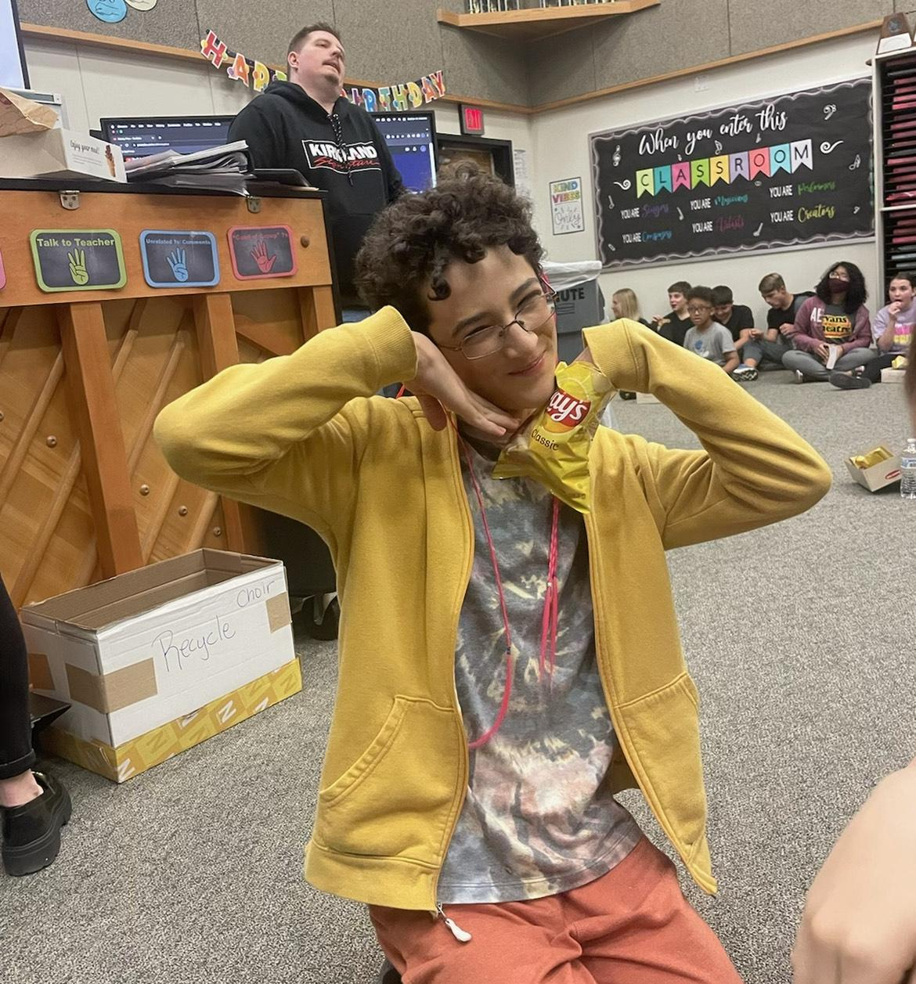

Slide 39
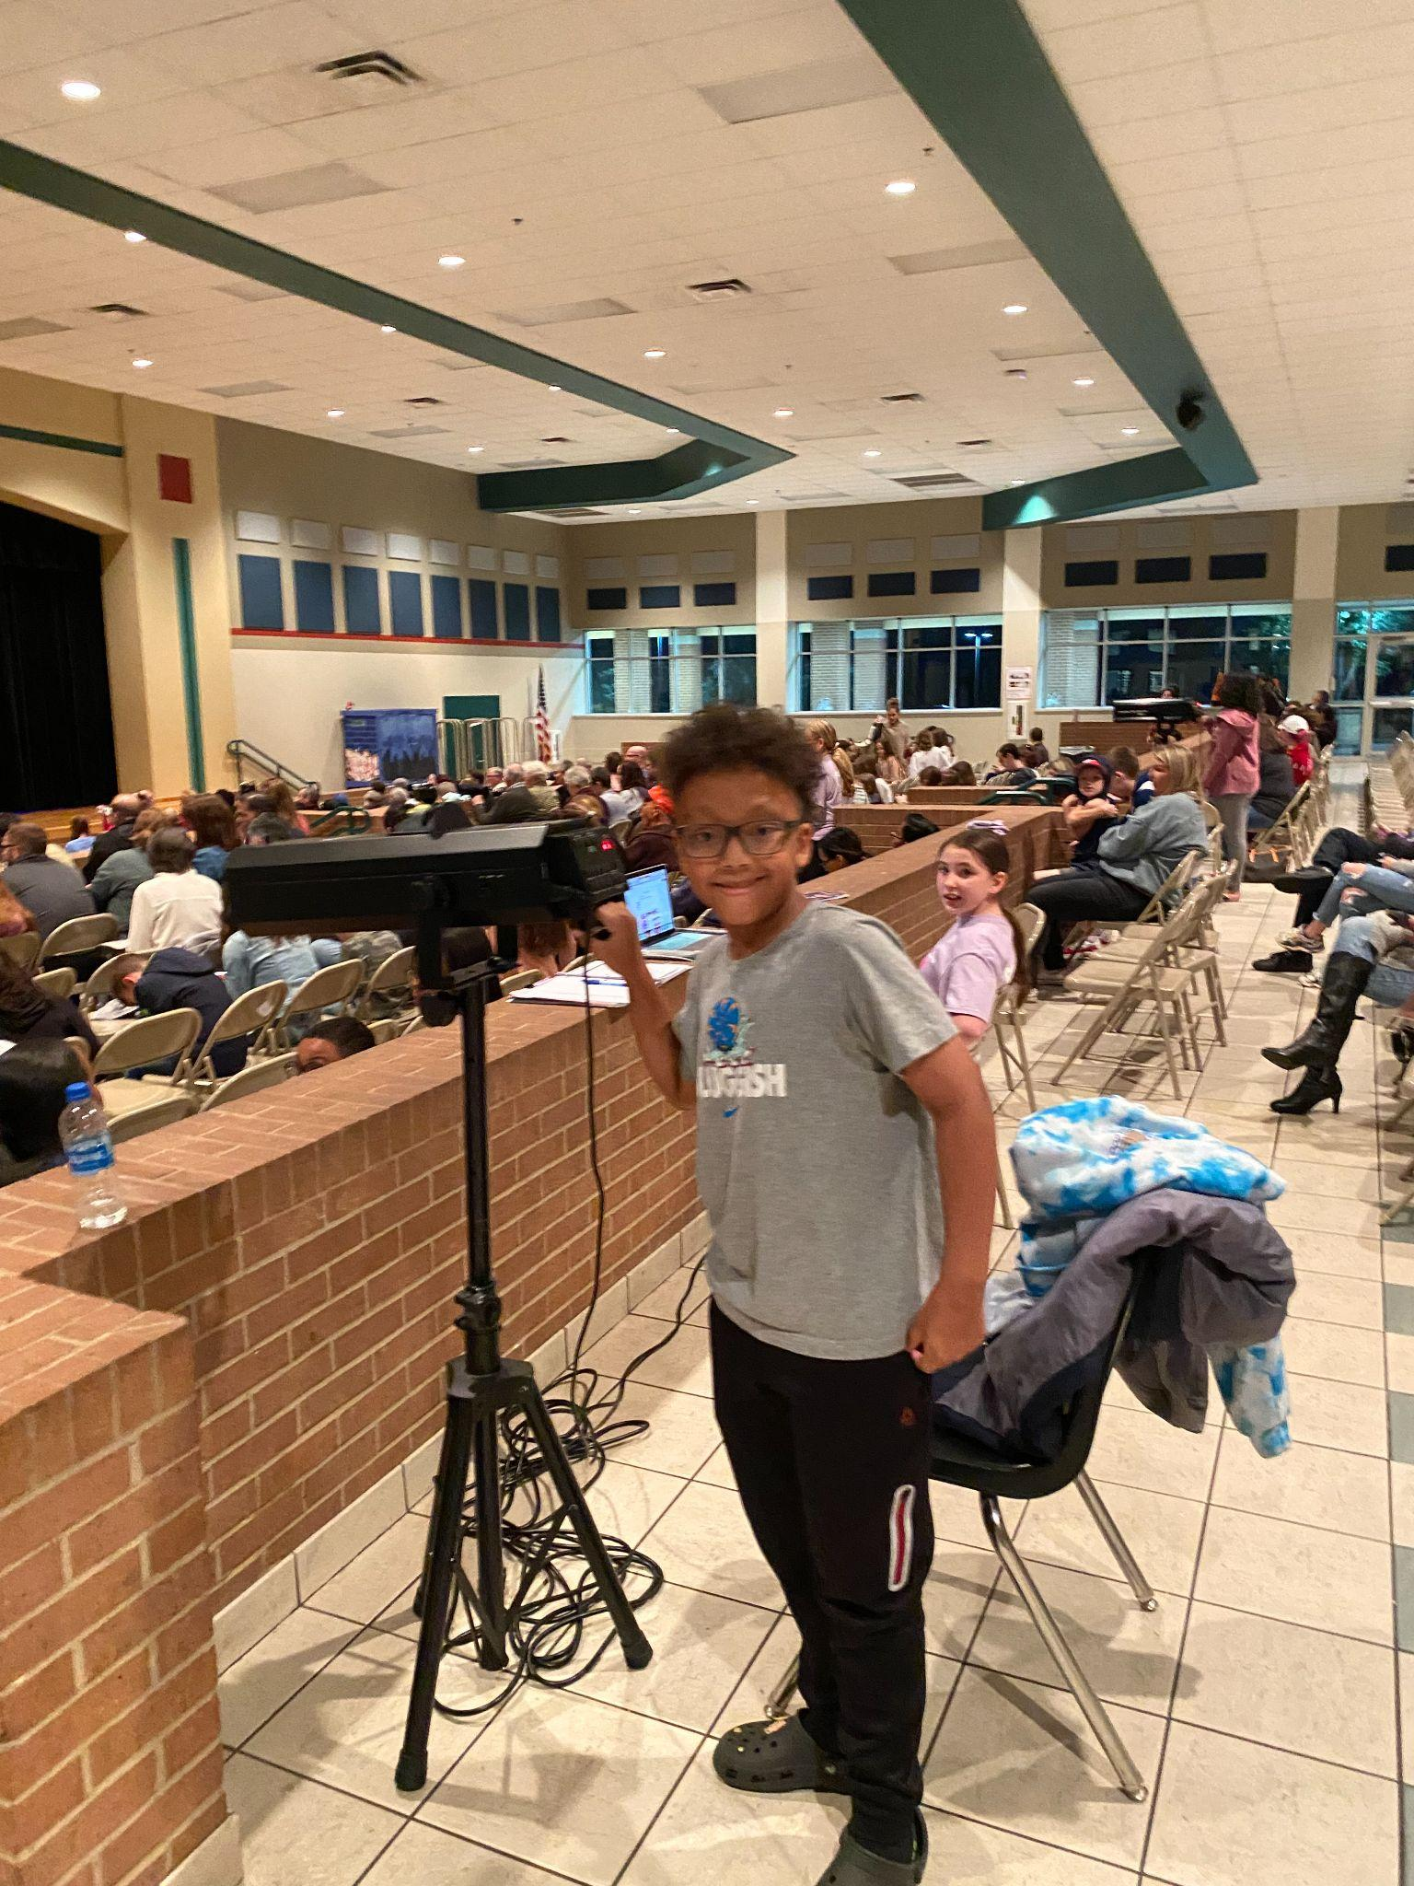

Slide 40
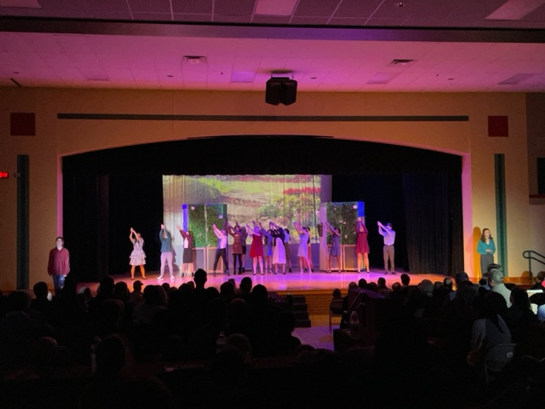

Slide 41
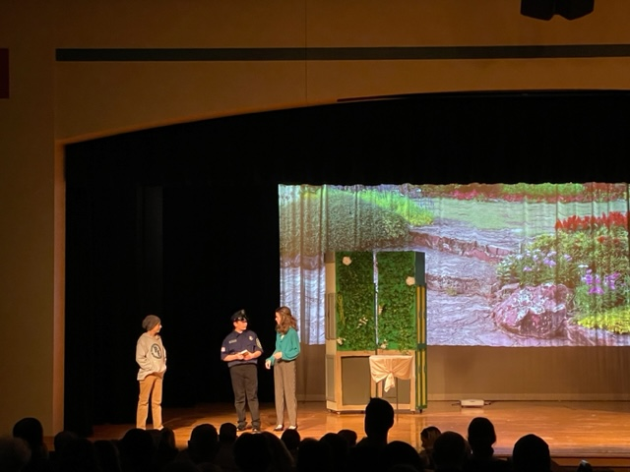

Slide 42
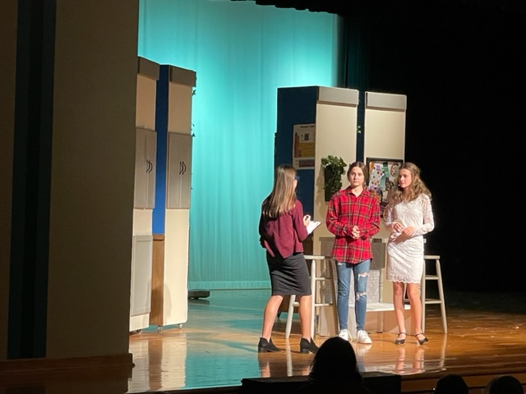

Slide 43
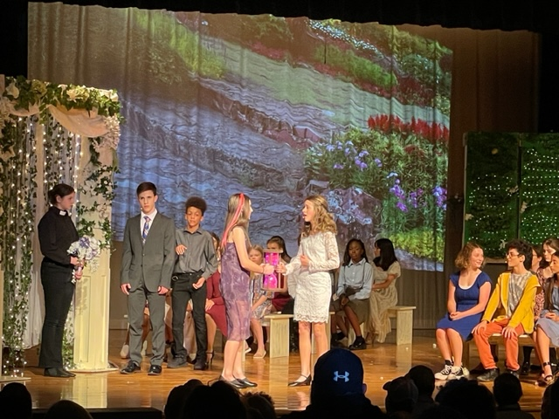

Slide 44
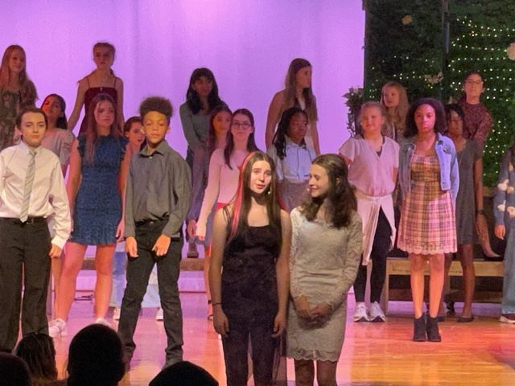

Slide 45
Our understudies were OUTSTANDING in their performance as well!

Slide 46
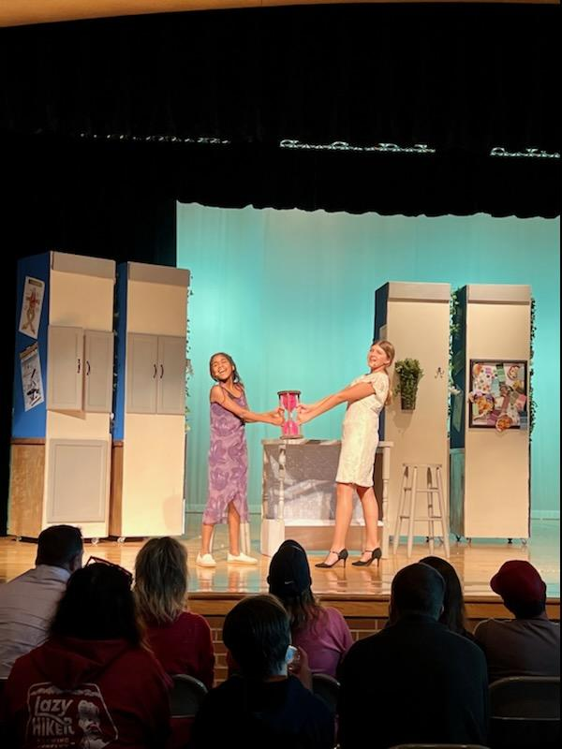

Slide 47
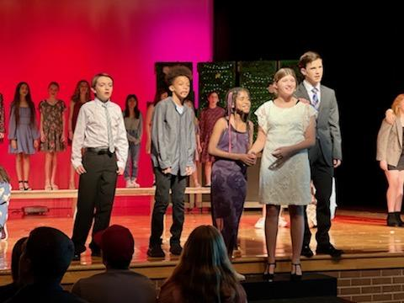

Slide 48
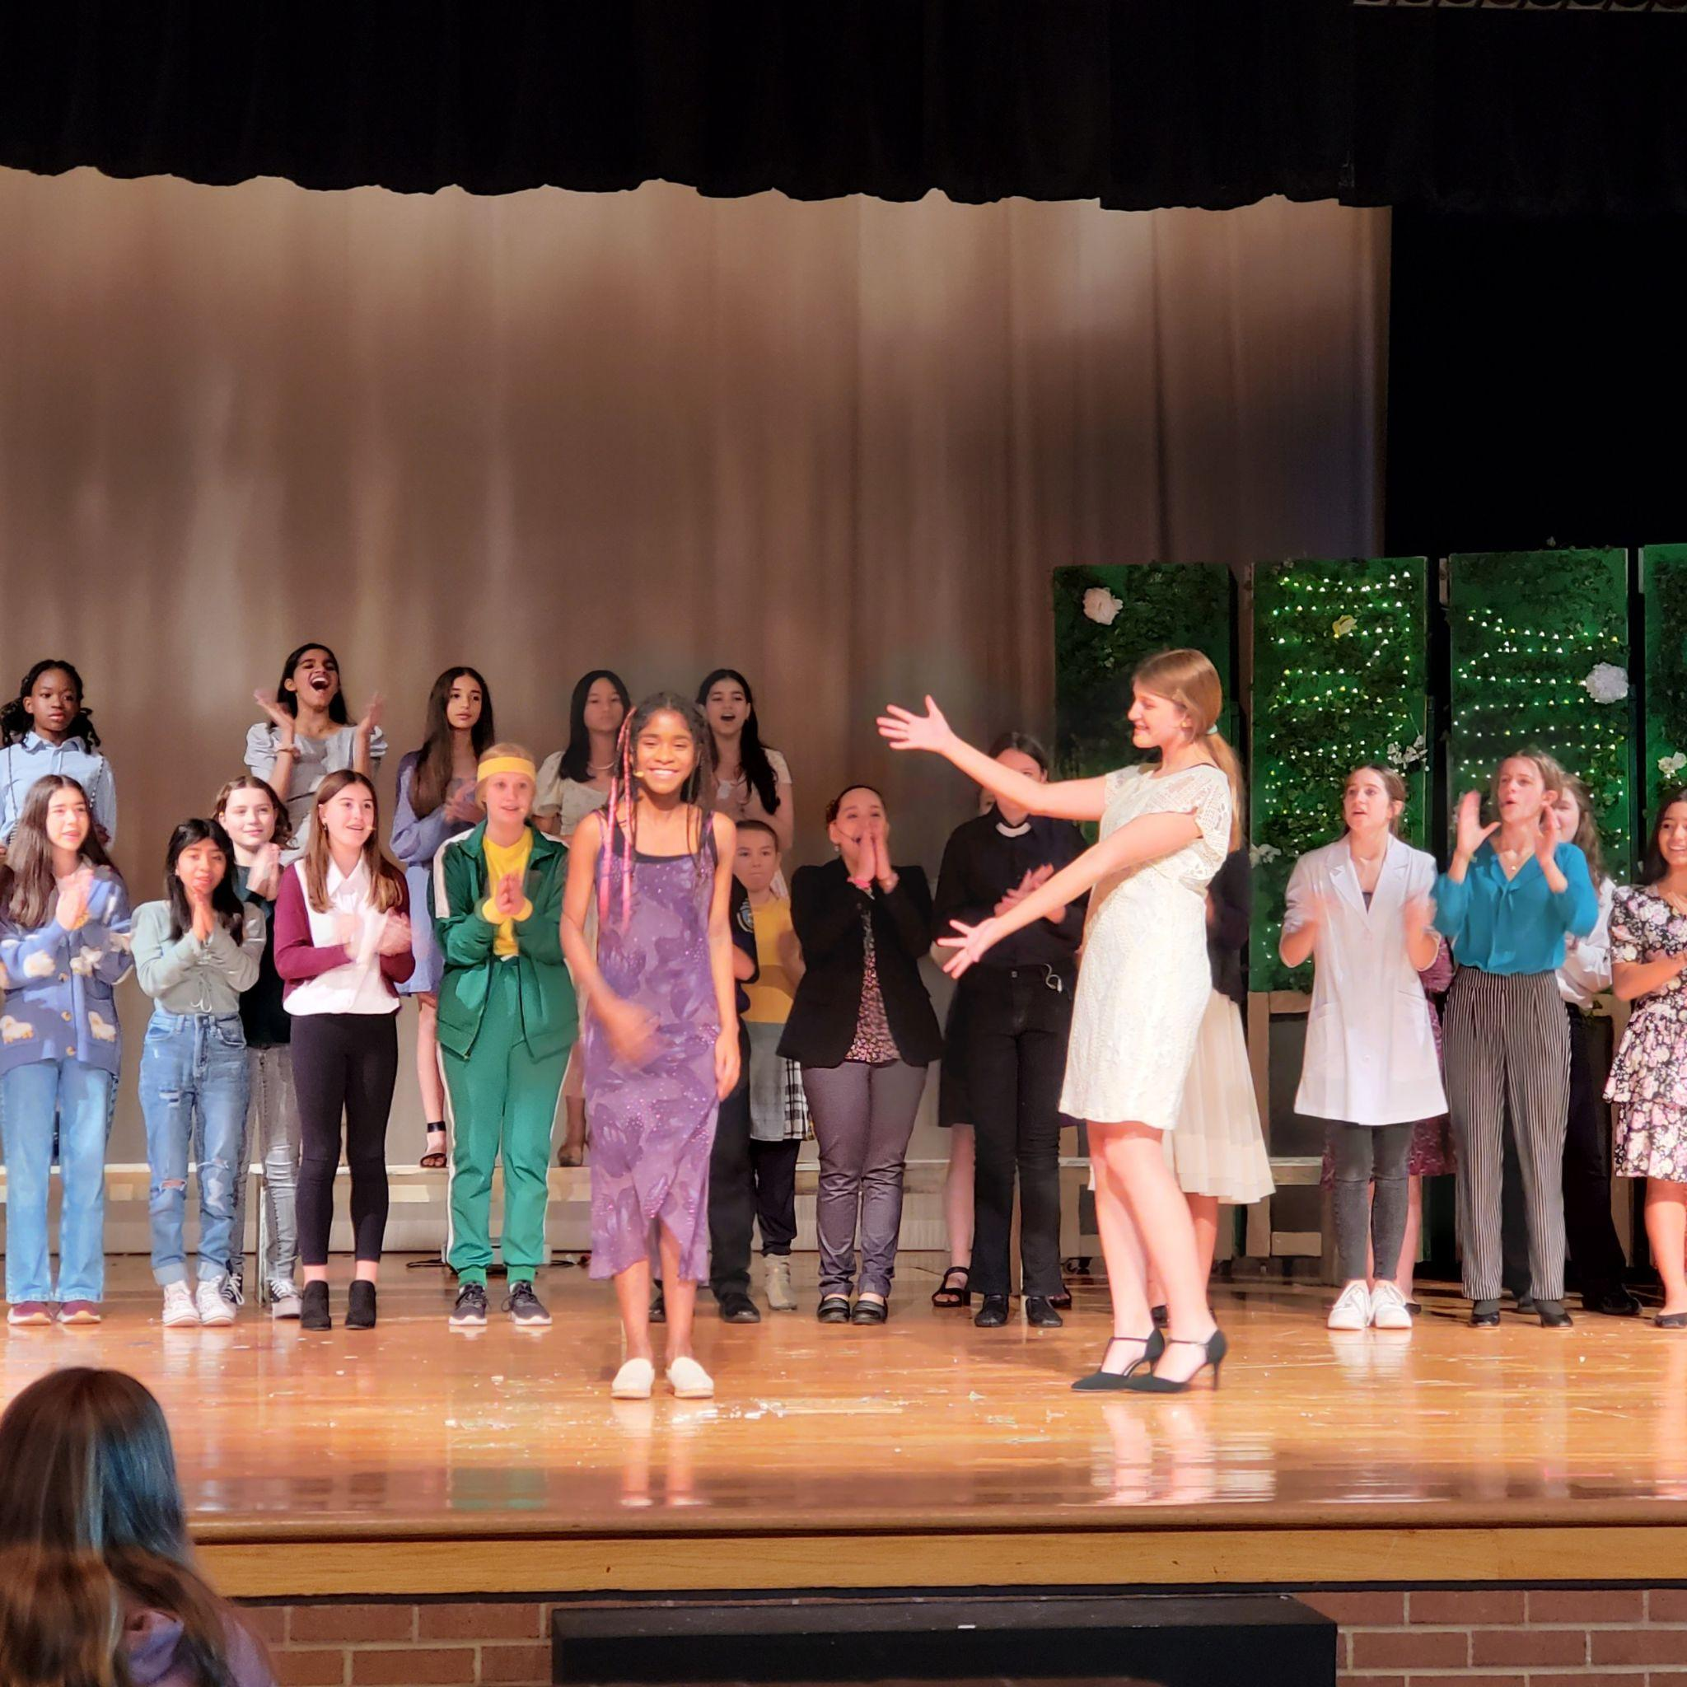
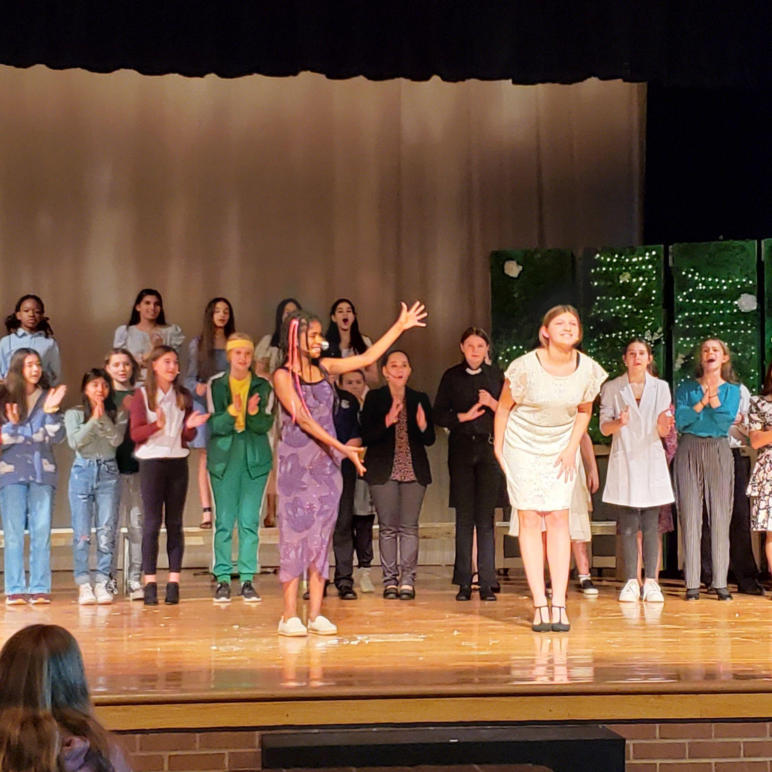

Slide 49
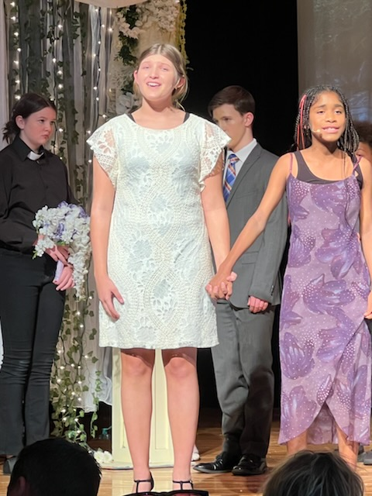

Slide 50
A Girl Called Opal
Evans UIL One Act Play

Slide 51
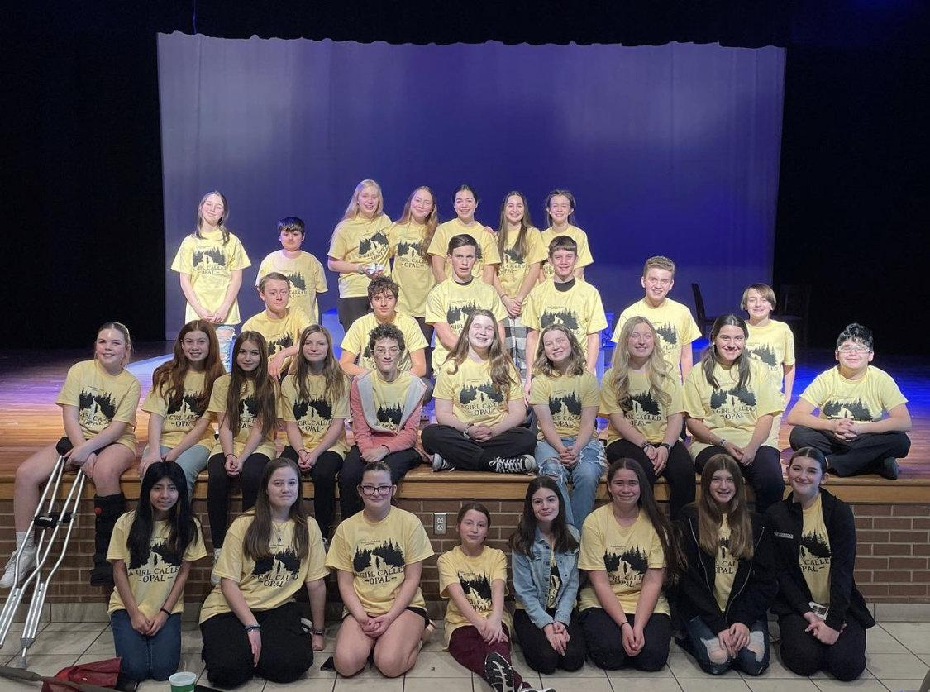

Slide 52
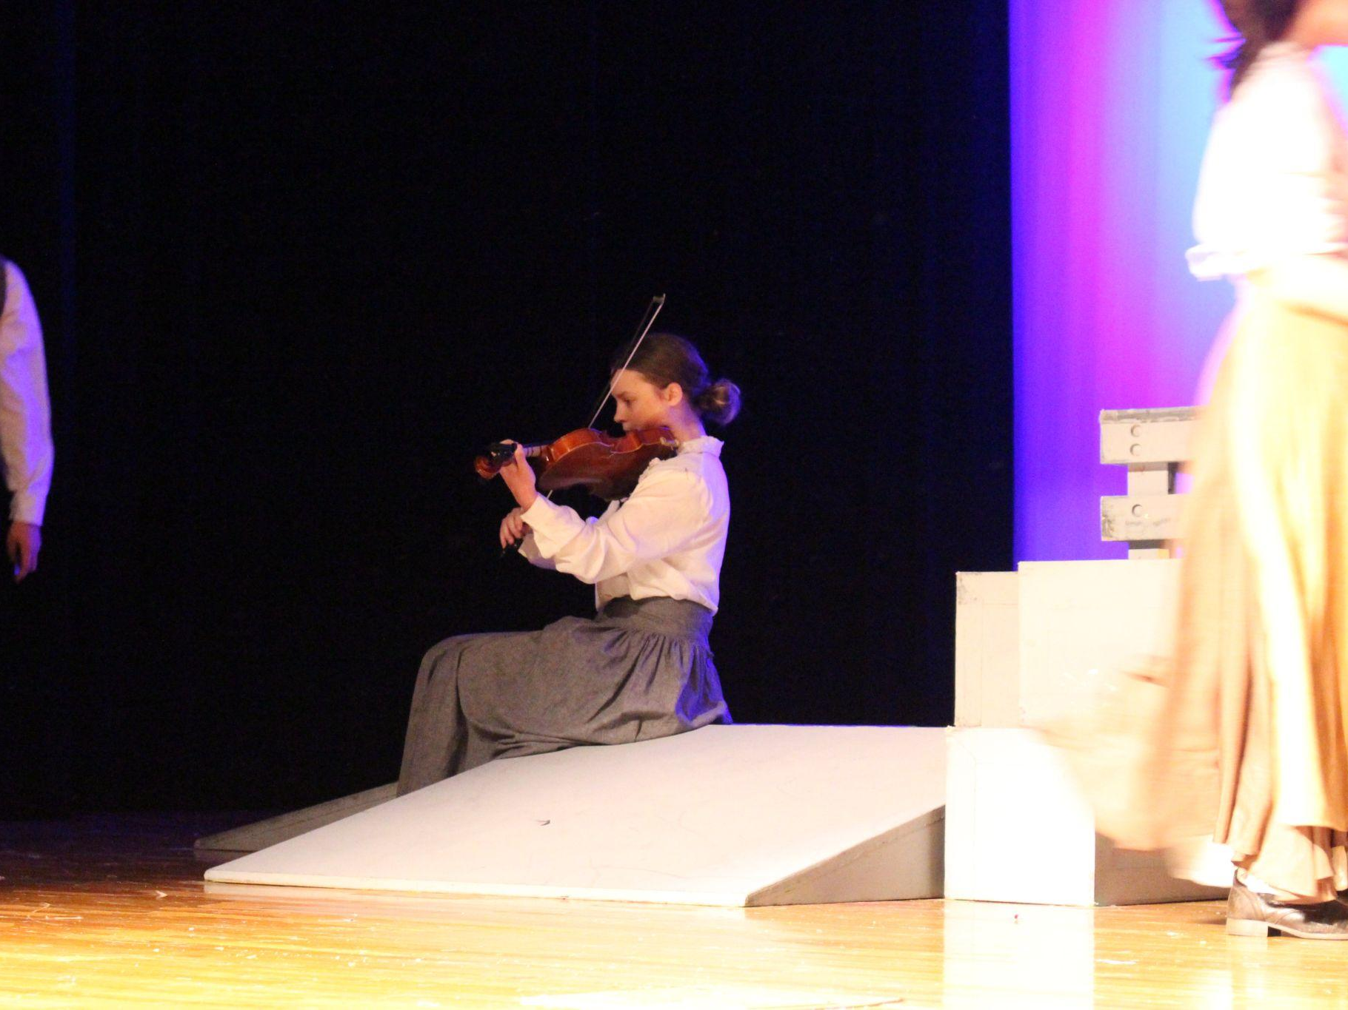

Slide 53
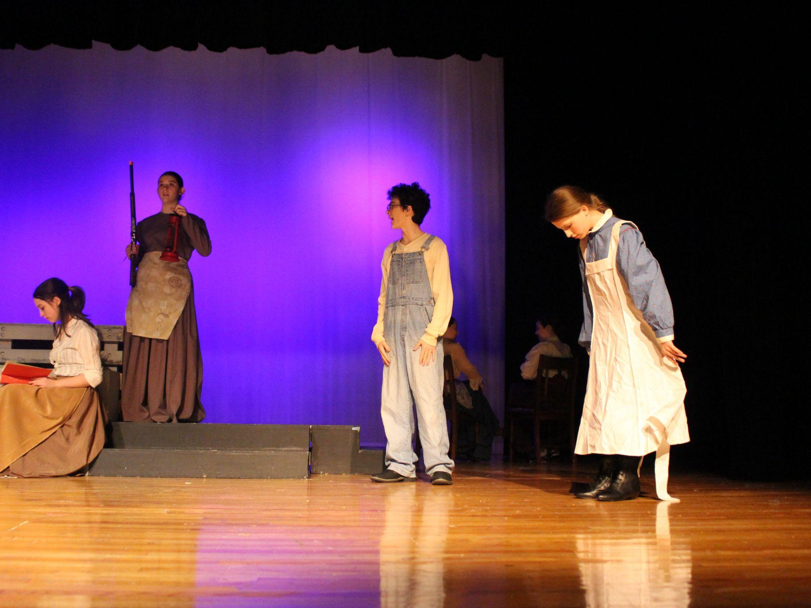

Slide 54
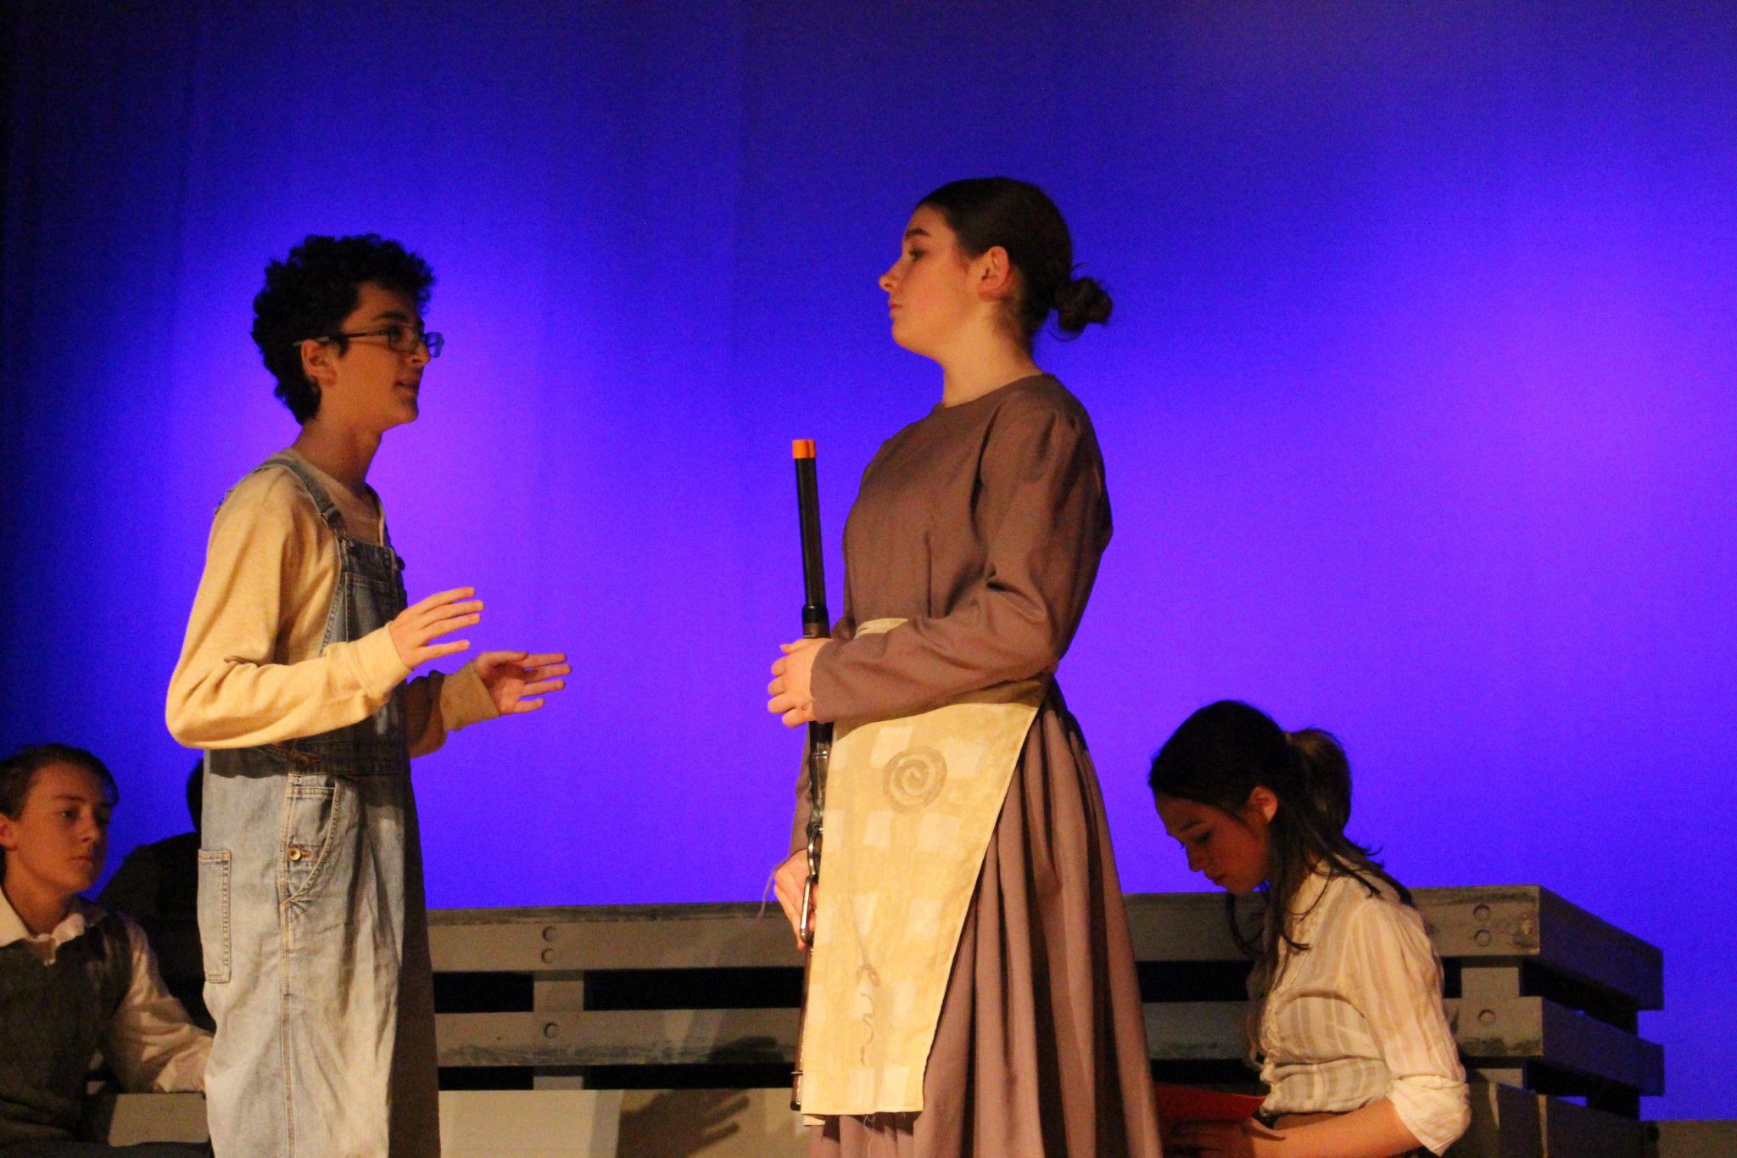

Slide 55
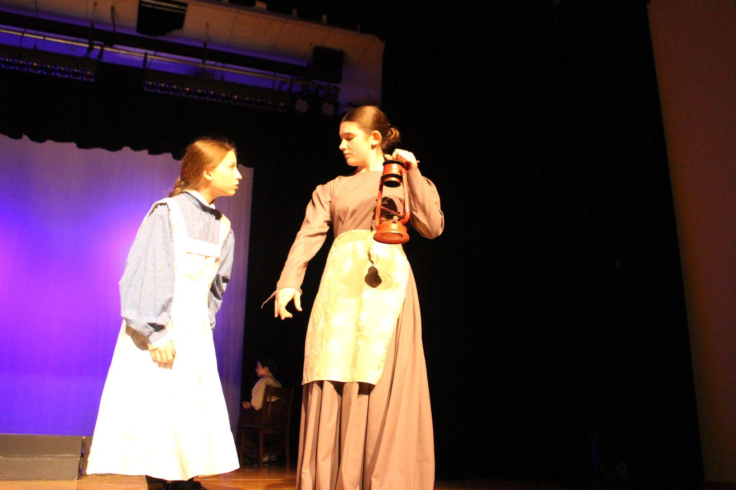

Slide 56
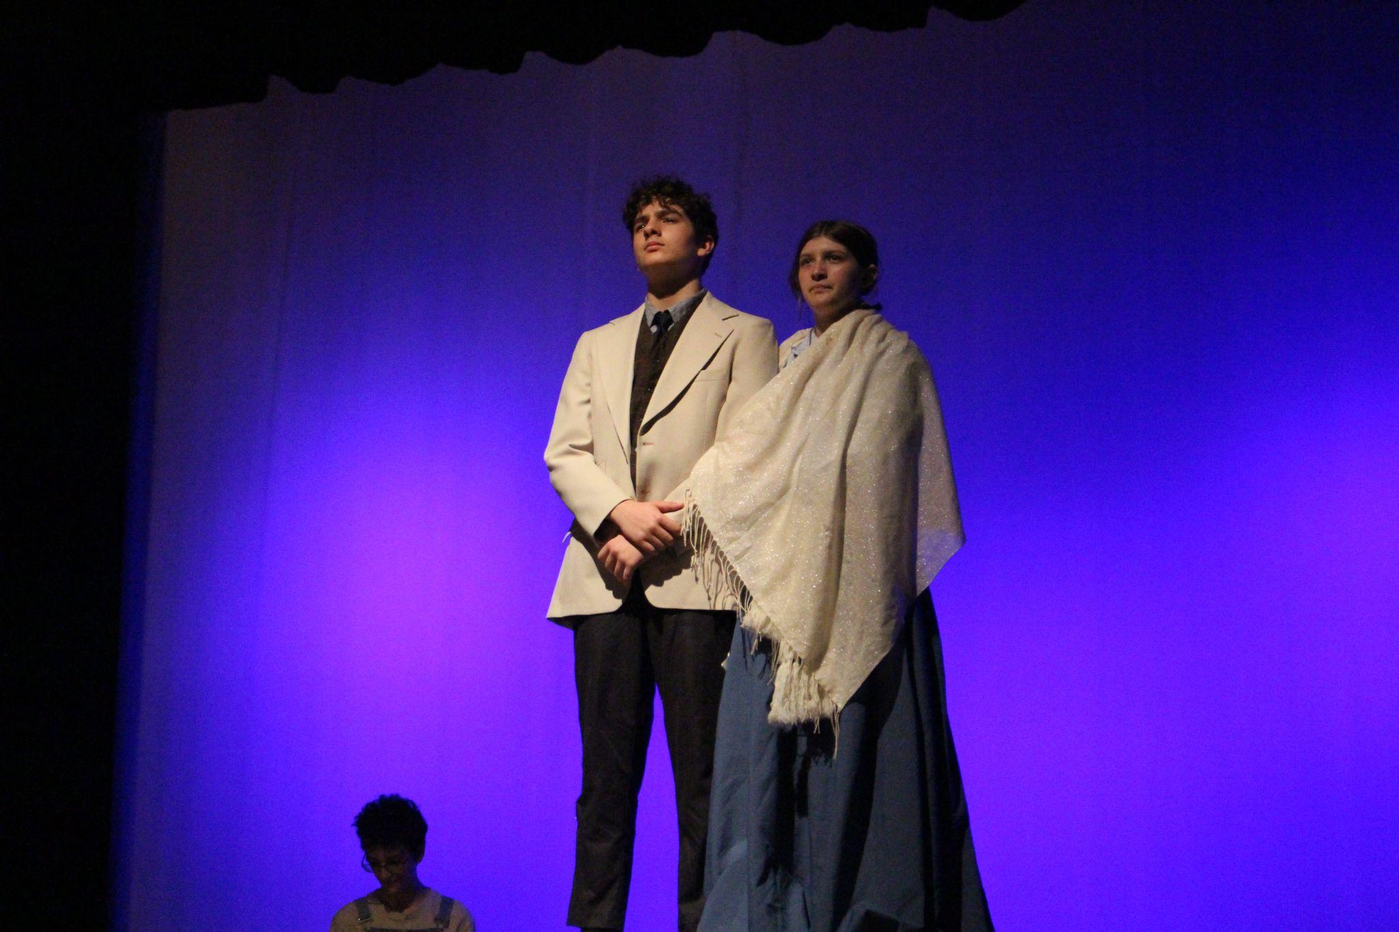

Slide 57
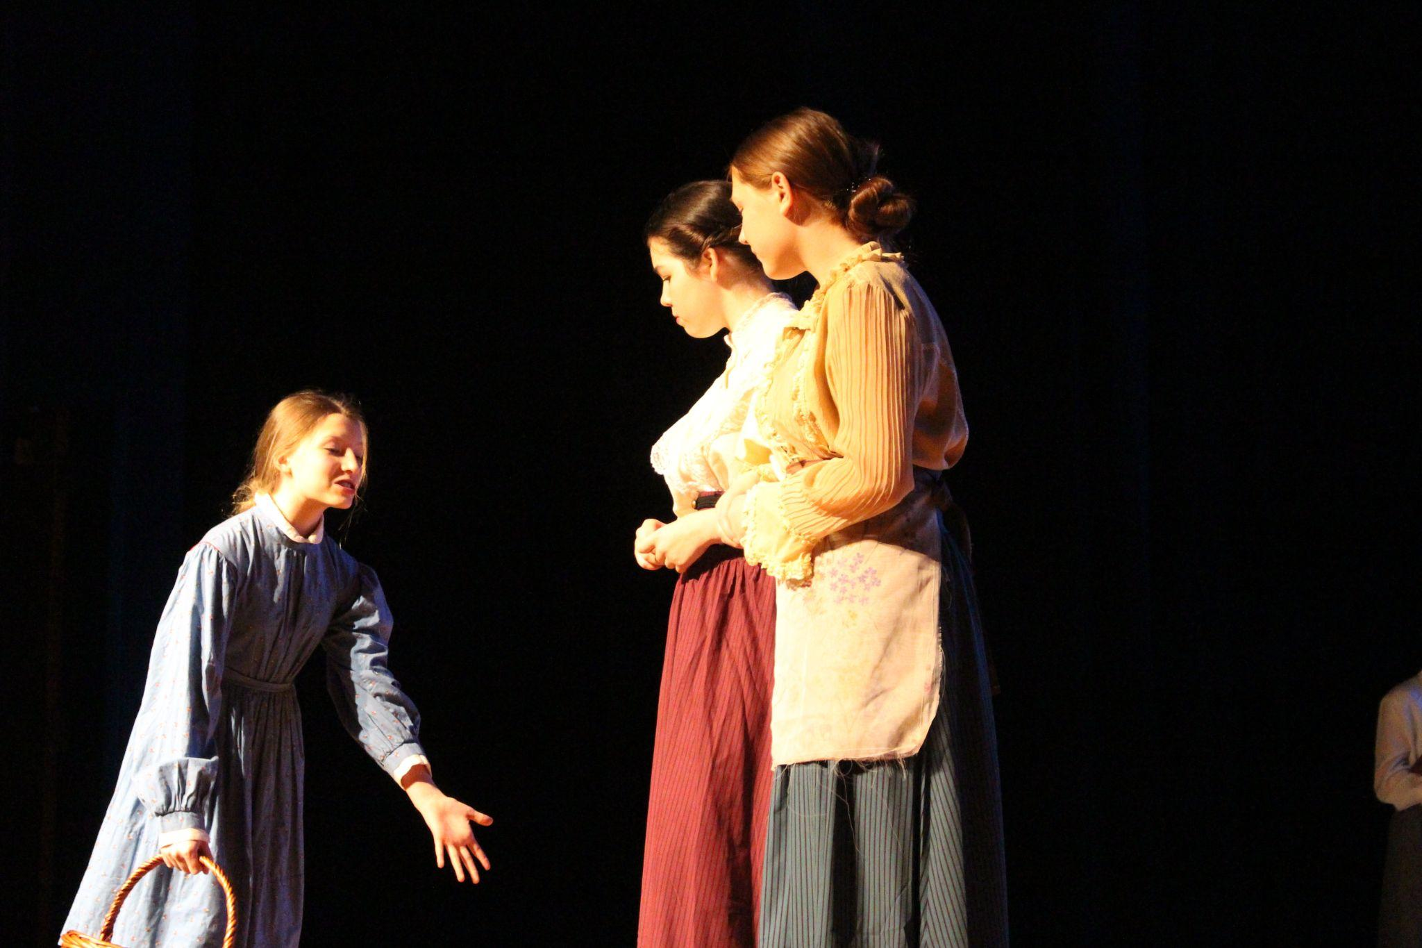

Slide 74
Special Night and secret thespian reveals!

Slide 77
Our Understudies were brilliant!

Slide 82
We had a very successful competition at the Mckinney/Wylie UIL OAP Contest!

Slide 83
3 of our crew members participated in the 1st annual design contest!

Slide 84
We took home several individual awards!

Slide 85
We won FIRST PLACE!

Slide 86
Theatre 2 Class Play
Everyone Gets Eaten by Sharks

Slide 108
Advanced Theatre’s traveling children’s show….
McQuadle: A Dragon’s Tale

Slide 120
We had a lot of fun touring to the elementary schools!

Slide 130
Backstage FUN!

Slide 139
6TC SHOW!
This is Your Brain on Social Media

Slide 150
And this is what happens when Ebs asks for some help…

Slide 154
To the Advanced Theatre 8th Graders...
We will miss you as you move onto high school! Thank you for the impact you made on the department during your years here! The leadership you provided has made us better.
Be brilliant on your high school stage!

Slide 172
STAY GOLD!

Slide 173
I’m so proud of this whole theatre department! Remember to enjoy the moments--and continue to
BE BRILLIANT!
-Ebs

